Slide 1
Houma Nation Gardening Practices
Natalie Lafont
Staff Scientist
Healthy Gulf

Slide 2
Topics
Soil Base
Companion planting
Three Sisters Method
Reducing the need for pesticides, herbicides and synthetic fertilizers
Nutritionally balanced garden
Planting
Harvesting
Storage

Slide 3
Soil Base

Slide 4
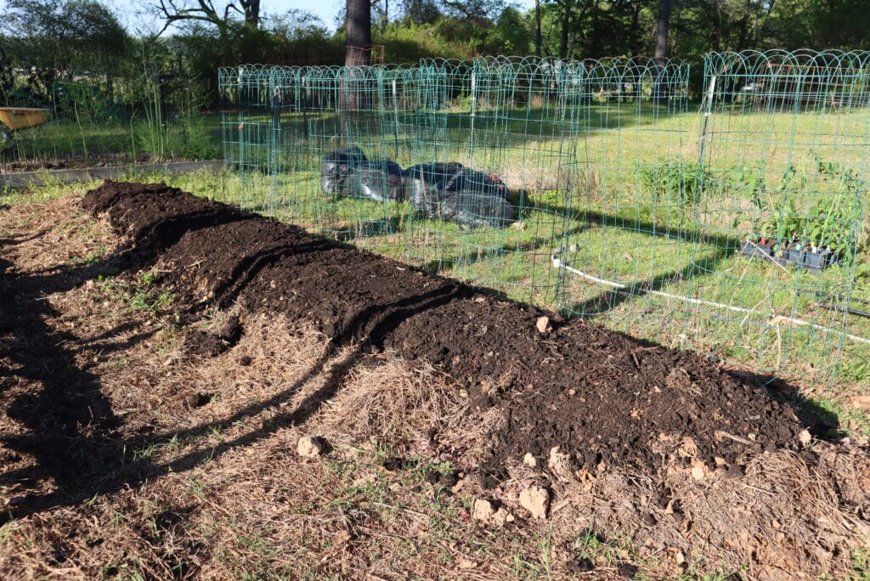
Soil
Traditionally, the Houma tribe gardened on long rows of soil mounds
These mounds contained black rich soil deposited from the river bed, then packed with burnt plant material
Burning breaks down the organic material of the plants into a usable form for plants to obtain nutrients from the soil
Nitrogen availability often limits crop growth
The availability of nitrogen and other nutrients in the soil drastically increases immediately after burning increasing garden yields

Slide 5
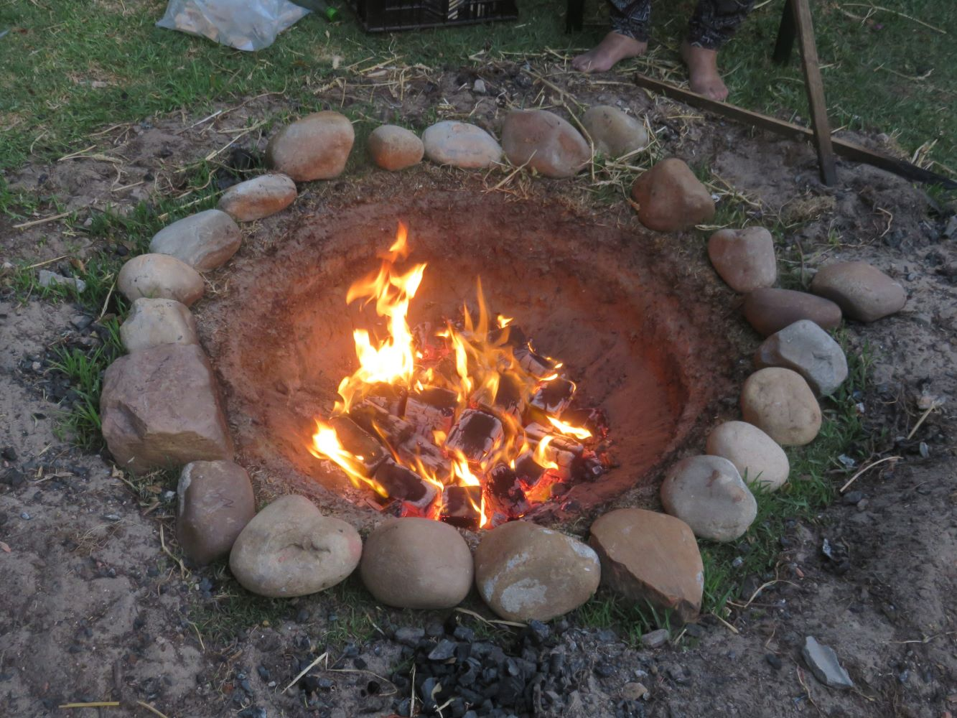
How to obtain burnt plant material (Biochar)
You can burn it yourself in a fire pit and deposit it into your garden
Make sure to use dry plant material so that it burns well
Do not use an accelerant
Start the fire with small dry twigs then add woody/larger dried plants
Deposit this in your garden:
Mix it into the top 4-6 inches of soil when planting or as a top dressing, and consider incorporating it into compost piles to charge it with nutrients and beneficial microbes
This acts as a natural and long-lasting fertilizer (and its free!)

Slide 6
Companion Planting/Three Sisters Method

Slide 7
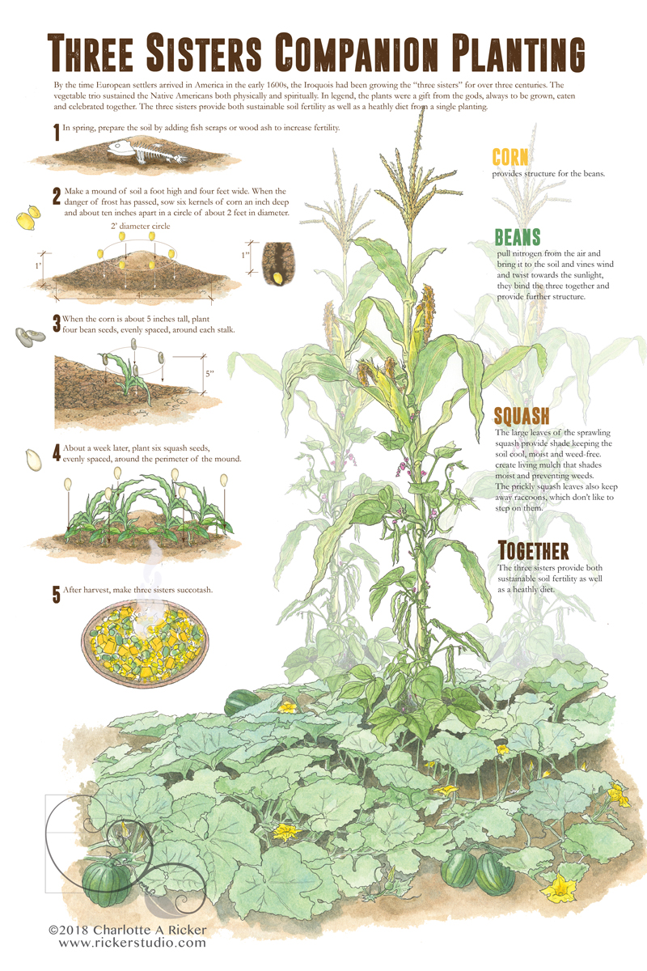
Companion Planting/Three Sisters Method: How its done
Plant Three Crops Together: Corn, beans, and squash are grown in the same plot.
Corn as Support: Tall corn stalks provide a natural trellis for climbing beans.
Beans for Nitrogen Fixation: Beans enrich the soil by fixing nitrogen, benefiting all plants.
Squash for Ground Cover: Broad squash leaves create shade, reducing weed growth and moisture loss.
Staggered Planting: Corn is planted first, then once the corn is 5 inches tall plant the beans, and then the squash last (one week after beans).
Spacing Considerations: Typically planted in small mounds to improve drainage and growth.

Slide 8
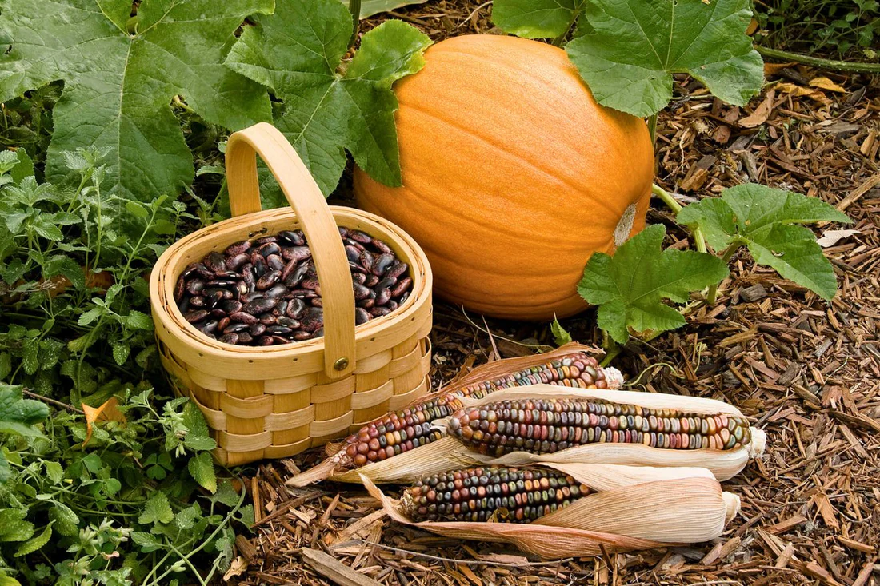
What is the benefit of this type of companion planting?
Maximizes Space: Vertical growth of beans and spreading squash optimize land use.
Enhances Soil Fertility: Beans add nitrogen, reducing the need for fertilizers.
Reduces Weeds: Squash’s sprawling vines block sunlight, suppressing weed growth.
Retains Soil Moisture: The ground cover provided by squash reduces evaporation.
Pest Control: The combination confuses pests and reduces infestations.
Improves Crop Yield: The symbiotic relationship leads to healthier, more productive plants.
Sustainable and Traditional: this method was developed by Indigenous peoples for sustainable agriculture.
Most of all: It is nutritionally balanced (these three plants provide all nine essential amino acids, forming a complete protein source. The Houma people rarely ate meat relying mostly on these three plants as a complete and balanced source of protein!
Notes:
The Three Sisters Method confuses pests through companion planting, which disrupts the usual visual and scent cues pests rely on to locate their preferred plants. Here’s how:
Diverse Plant Structures: Corn grows tall, beans climb, and squash spreads low, creating a complex, layered environment that makes it harder for pests to navigate and find their target.
Masking Scents: The combination of different plants releases a mix of chemical compounds that can mask the scent of individual plants, making it harder for pests to detect their preferred host.
Physical Barriers: The sprawling squash vines create a dense, prickly ground cover that deters crawling pests like vine borers and some beetles from reaching the stems of corn and beans.
Disrupting Pest Reproduction: Some insects prefer to lay eggs on exposed soil or near the base of plants; the squash’s broad leaves shade the ground and interfere with this process.
Attracting Beneficial Insects: The diversity of plants supports pollinators and predatory insects (like ladybugs and parasitic wasps) that help control pest populations naturally.
This method mimics natural ecosystems, making it harder for pests to thrive while promoting plant health.

Slide 9
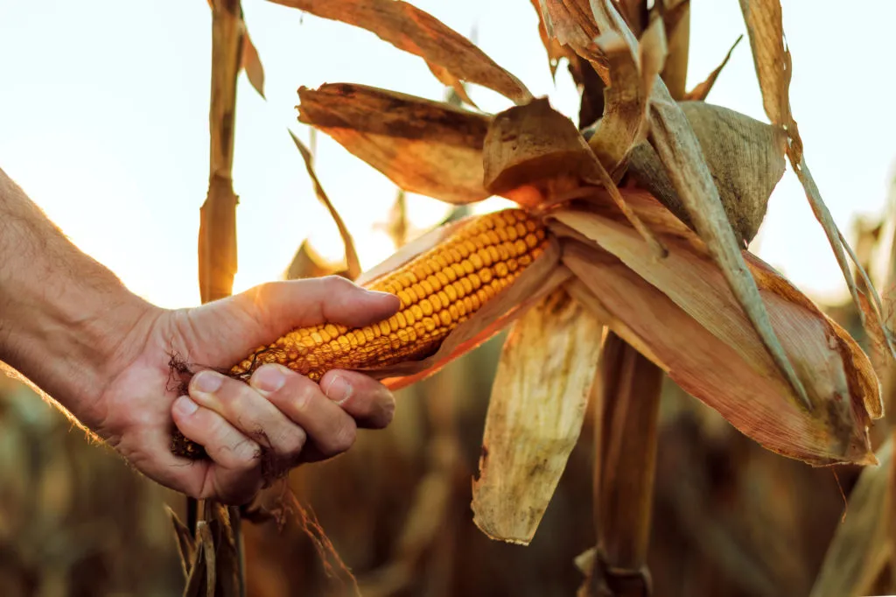
Harvesting
Corn: Harvest when kernels are plump and milky when punctured (for sweet corn) or when husks dry out for flour or storage corn.
Beans: Pick fresh green beans while tender or allow them to fully mature and dry on the vine for long-term storage.
Squash: Harvest summer squash (like zucchini) while skin is tender; winter squash (like pumpkins) should be picked when the skin hardens and vines begin to die back.

Slide 10
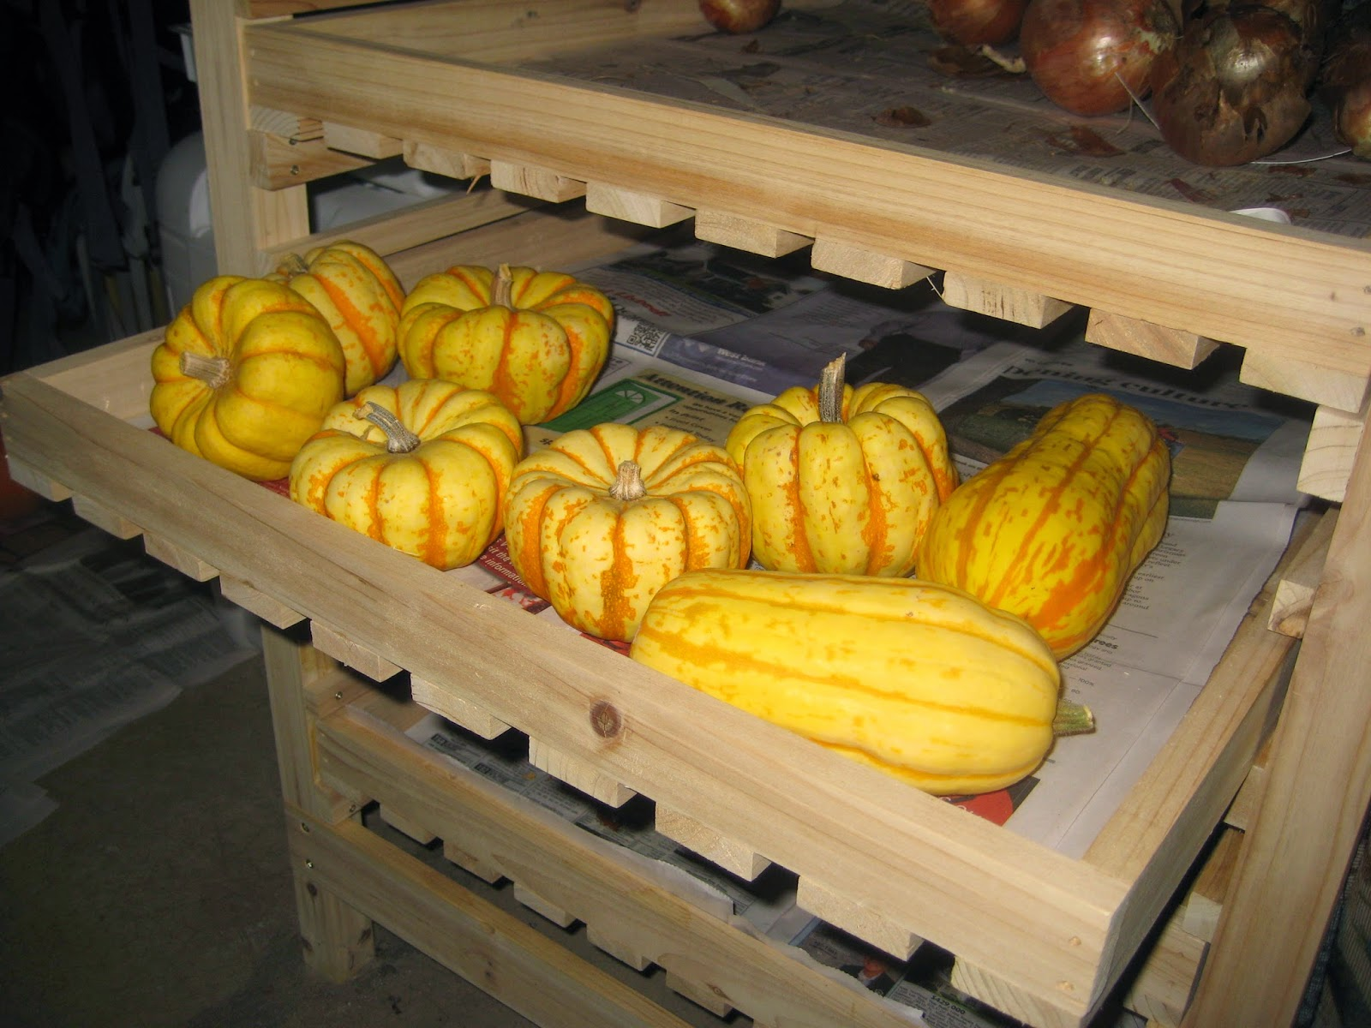
Storing
Corn: Dry completely before shelling and storing in airtight containers or grind into meal/flour for long-term storage.
Fresh sweet corn: 1–2 weeks in the refrigerator.
Dried corn (for grinding or popping): 6 months to several years if stored in a cool, dry place in airtight containers.
Beans: If dried, store in jars or cloth bags in a cool, dry place; fresh beans can be blanched and frozen.
Fresh beans: up to 1 week in the refrigerator.
Blanched and frozen beans: 8–12 months in the freezer.
Dried beans: up to 2–3 years if kept in a cool, dry, airtight container
Squash: Store winter squash in a cool, dry area (50–55°F) with good air circulation; summer squash can be refrigerated or frozen after blanching.
Summer squash (e.g., zucchini): 1–2 weeks in the fridge; up to 1 year if blanched and frozen.
Winter squash (e.g., butternut, pumpkin): 3–6 months when stored in a cool, dry place; up to 1 year if cured properly and stored at optimal temperatures (50–55°F).

Slide 11
Best Three Sisters Varieties for Louisiana
Louisiana’s hot, humid climate with a long growing season means selecting heat-tolerant, disease-resistant varieties that thrive in this environment.
Corn 🌽
‘Hickory King’ – Large, sturdy stalks provide excellent support for beans; great for cornmeal and grits.
‘G90’ – A hybrid sweet corn that tolerates humidity and has good disease resistance.
‘Stowell’s Evergreen’ – A classic, long-season heirloom sweet corn.
‘Cherokee White Eagle’ – A traditional Native American variety suited for flour and meal.
Beans 🌱
‘Kentucky Wonder’ – A vigorous pole bean with excellent heat tolerance and productivity.
‘Rattlesnake’ – Heat-resistant and drought-tolerant with unique striped pods.
‘Blue Lake Pole’ – A reliable, disease-resistant heirloom variety.
‘Red Scarlet Runner’ – Thrives in Louisiana’s warm climate and attracts pollinators.
Squash 🎃
‘Waltham Butternut’ – Resistant to pests and stores well for months.
‘Seminole Pumpkin’ – A traditional Native American variety that withstands heat and humidity.
‘Cushaw Squash’ – A Southern favorite that resists vine borers better than other squash.
‘Early Prolific Straightneck’ – A heat-tolerant summer squash with a steady yield.

Slide 12
Take Aways
The traditional methods of farming used by the Houma people utilize natural fertilizers and companion planting to create a balanced garden ecosystem.
The crops used in this method can be stored for many months and provide all the essential amino acids required for your body to build proteins.
This method reduces the need for pesticides, herbicides, and synthetic fertilizers

Slide 13
Take aways
The traditional methods of farming used by the Houma people use natural fertilizers and companion planting to create a balanced garden ecosystem.
The crops used in this method can be stored for many months and provide all the essential amino acids required for your body to build proteins.
This method reduces the need for pesticides, herbicides, and synthetic fertilizers

Slide 14
Thank you

