Slide 1
What is an Ecosystem?
Natalie Lafont
Staff Scientist
Healthy Gulf

Slide 2
What is an Ecosystem?
These interactions form a web of life where everything depends on everything else.
Two main parts:
Biotic = living things
Abiotic = non-living things (sunlight, water, minerals)
An ecosystem is a community of living organisms (plants, animals, fungi, and microbes) interacting with their non-living environment (air, water, soil, and climate).

Slide 3
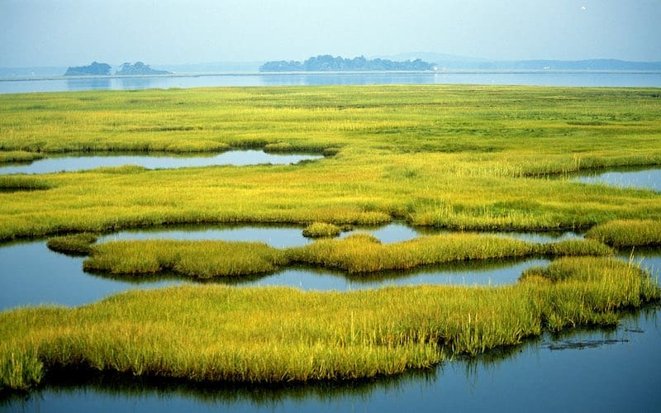
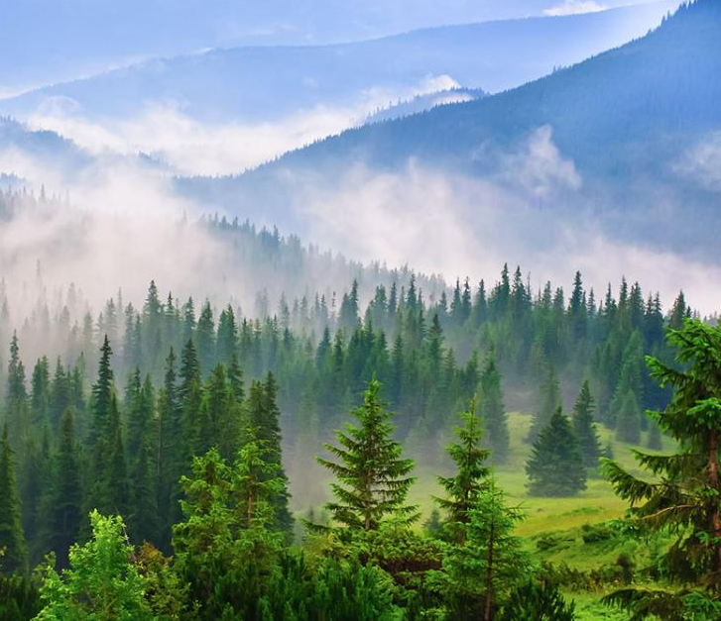
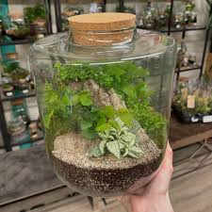
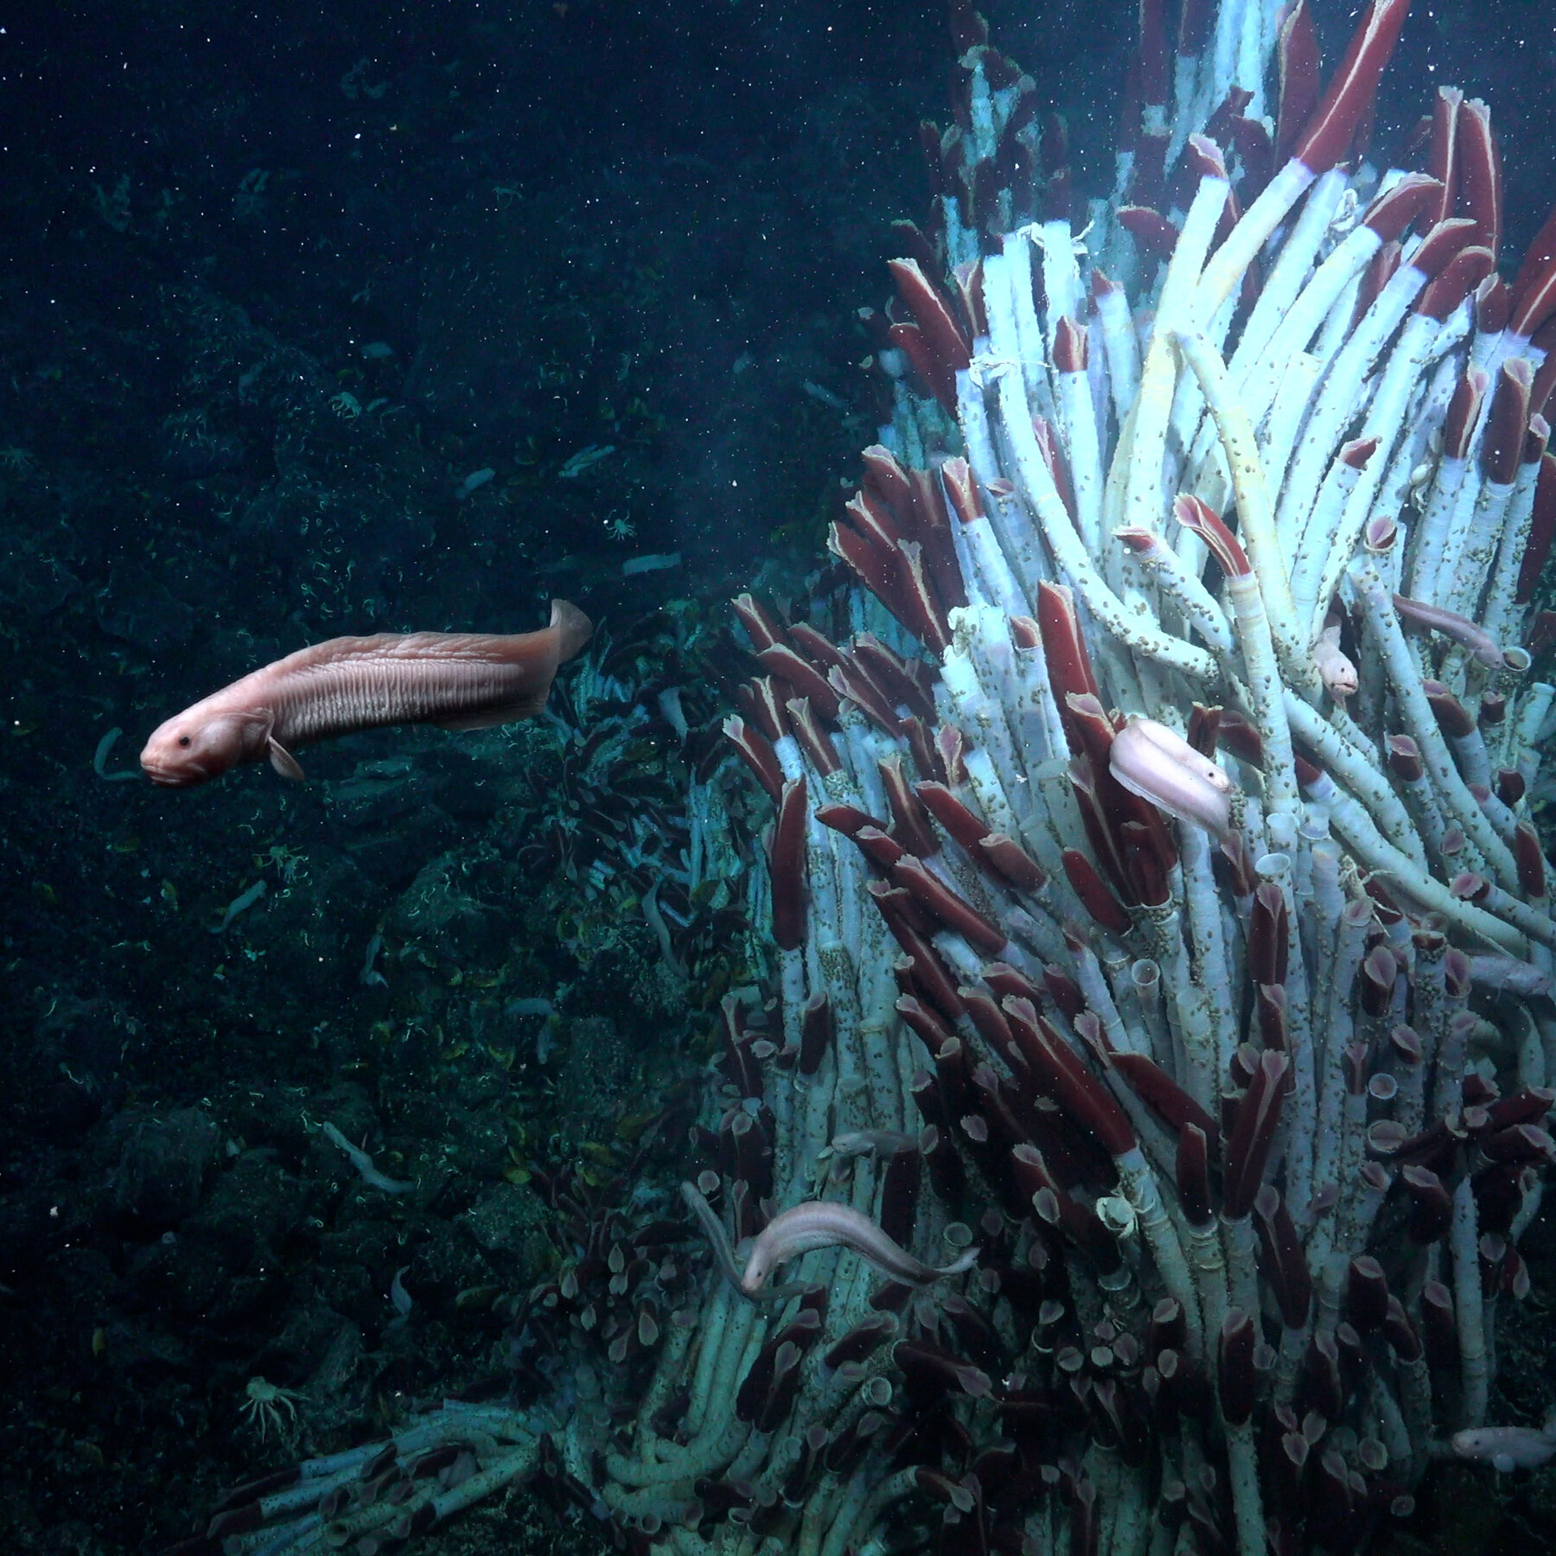
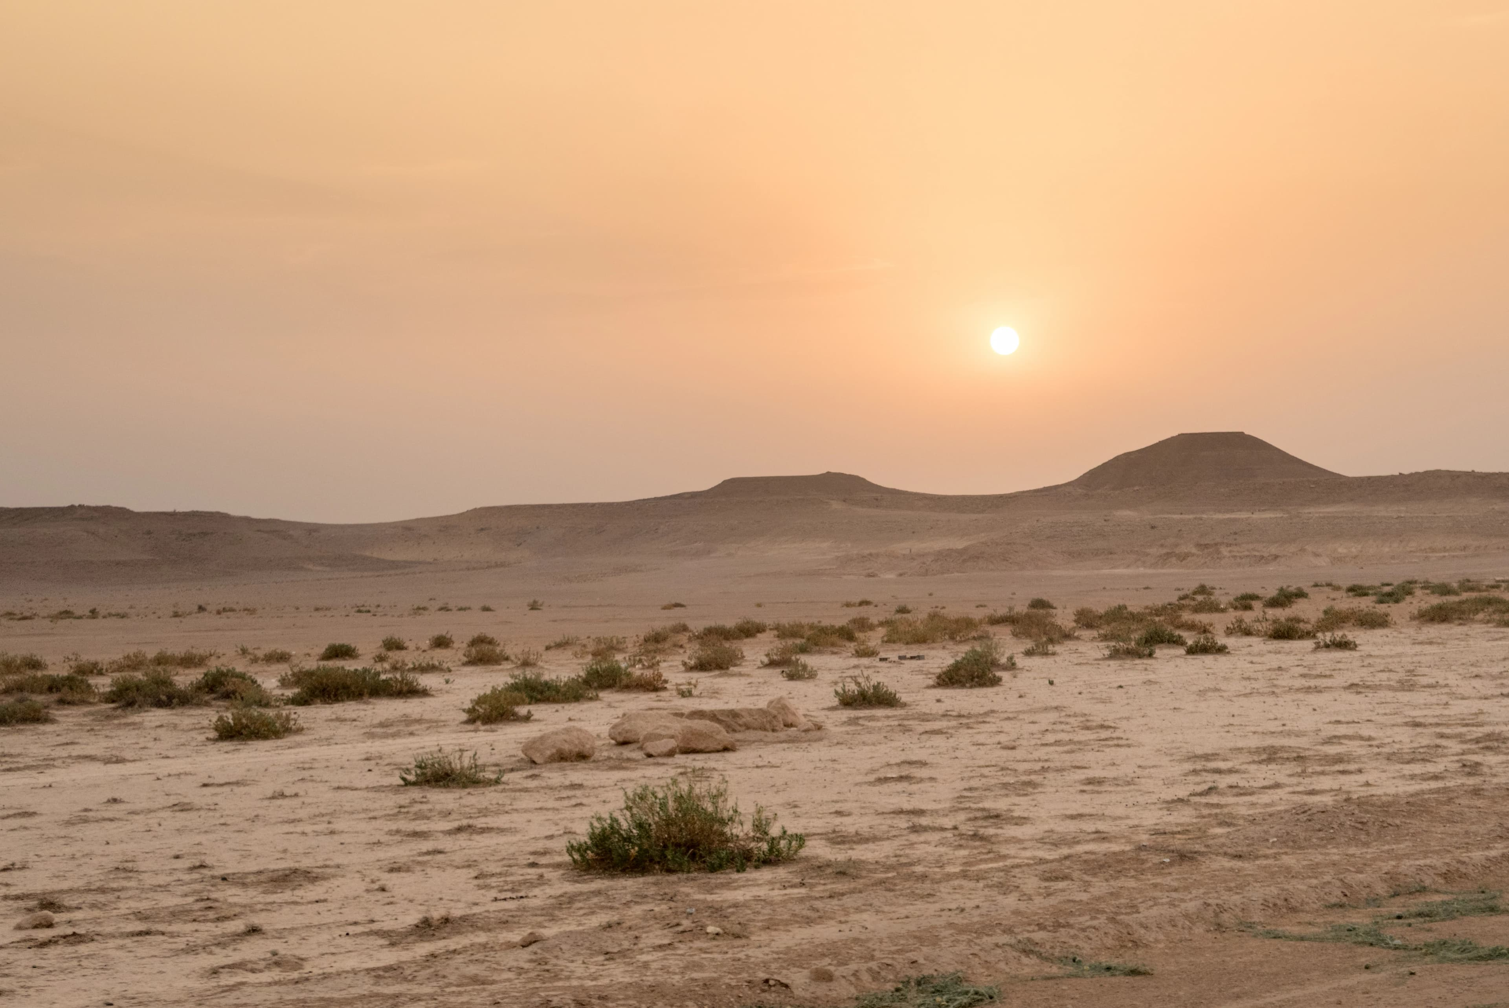
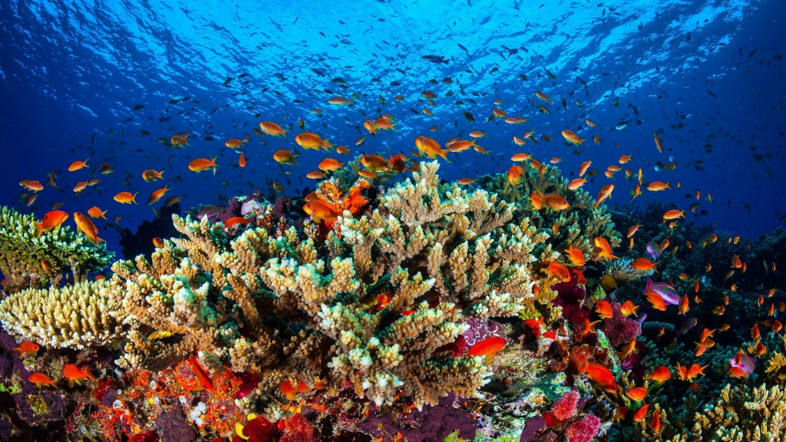
All Shapes and Sizes
Examples:
Forests
Wetlands
Oceans
Deserts
Deepsea vents
Terrariums

Slide 4
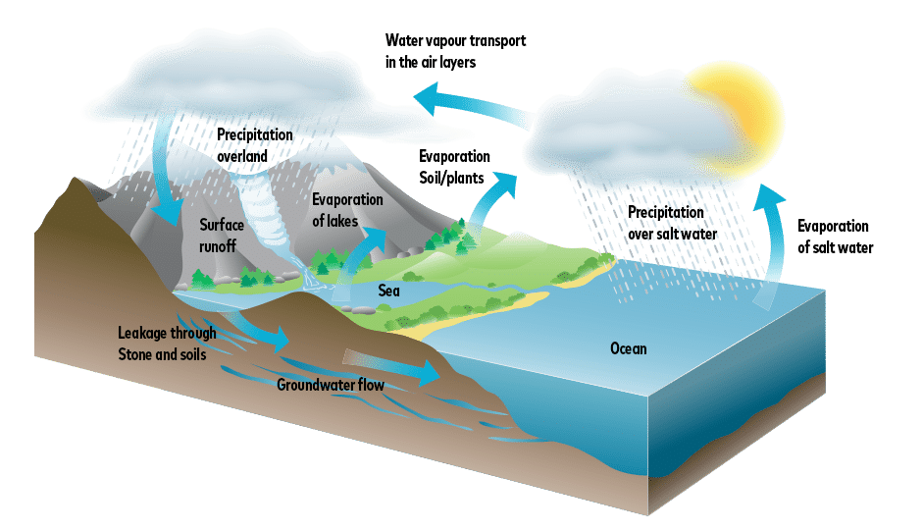
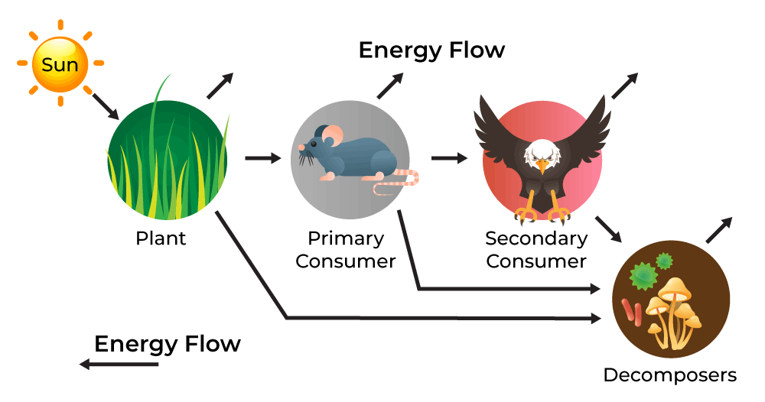
How Ecosystems Work
Ecosystems are all about balance and flow:
1. Energy Flow:
Starts with an energy source like the sun or even chemicals (in deep sea vents)
Producers make food through photosynthesis or chemosynthesis
Consumers eat plants or other producers
Decomposers (fungi, bacteria) break down dead stuff to recycle nutrients
2. Cycles:
Water Cycle
Carbon Cycle
Nitrogen Cycle These cycles keep resources moving and ecosystems healthy.
An ecosystem is a community of living organisms (plants, animals, fungi, and microbes) interacting with their non-living environment (air, water, soil, and climate).

Slide 5
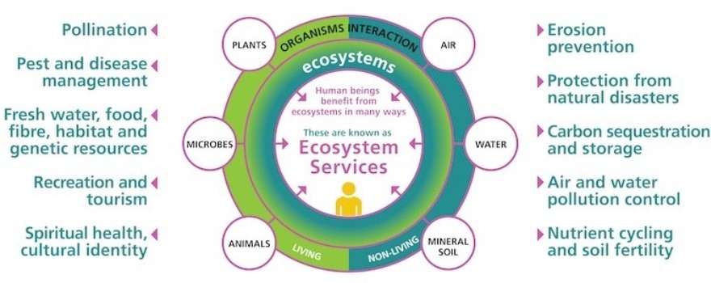
Why Ecosystems Matter
When we harm ecosystems (pollution, habitat loss, climate change), we also hurt ourselves.
Ecosystems give us:
Clean air and water
Food and medicine
Climate regulation
Pollination
Cultural and spiritual value

Slide 6
How Can We Help?
Protect natural areas
Reduce waste and plastic use
Plant native species
Support conservation and environmental justice efforts
Community education

Slide 7
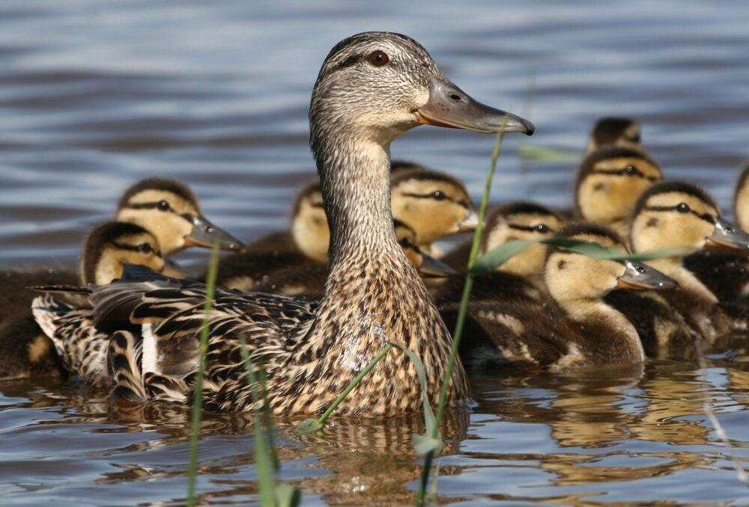
Key Takeaways
They cycle energy and nutrients in complex but beautiful ways
We rely on them—and we can also learn from them
Even small systems like terrariums can teach big lessons
“When we care for ecosystems, we care for ourselves.”
Ecosystems are interconnected systems of life

Slide 8
