Slide 1
PFAS & VOCs
In the Calcasieu Estuary

Slide 2
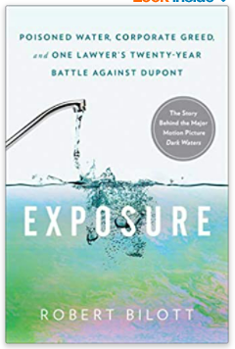



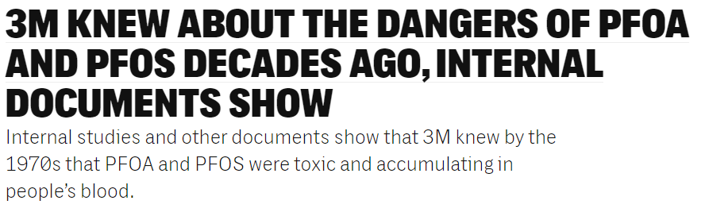
It’s what you don’t know that can hurt you…
PFAS, aka:
C8
Teflon®
PFOA or APFO
“PFOA-Free”
PTFE
“Devil’s P---”

Slide 3
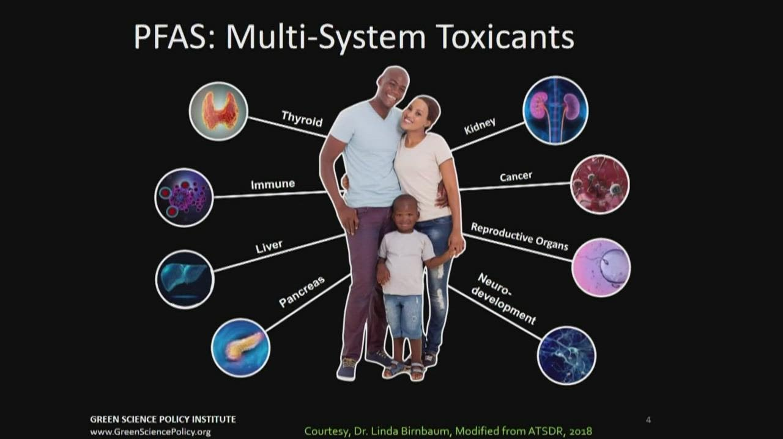

Slide 4

Health Effects of PFOS-C8 Study
N=69,030 2005-2006 exposed to water contamination had higher level of:
Kidney cancer
Testicular cancer
Ulcerative colitis
Thyroid disease
Hypercholesterolemia
Pregnancy-related hypertension
https://ehp.niehs.nih.gov/doi/10.1289/ehp.0800379
Notes:
The story dramatizes Robert Bilott's case against the chemical manufacturing corporation DuPont after they contaminated a town with unregulated chemicals.

Slide 5
Potential Associated Health Outcomes – PFOA and/or PFOS
Humans
Increased cholesterol levels
Changes in liver enzymes
Decreased antibody response to vaccines
Increased risk of thyroid disease
Small decreases in infant birth weights
Pregnancy-induced hypertension or pre-eclampsia
Increased risk of kidney or testicular cancer
Notes:
Animals
Developmental effects
Reproductive effects
Liver effects
Endocrine effects (thyroid)
Immune effects
Tumors (liver, testicular*, pancreatic)
* PFOA only

Slide 6
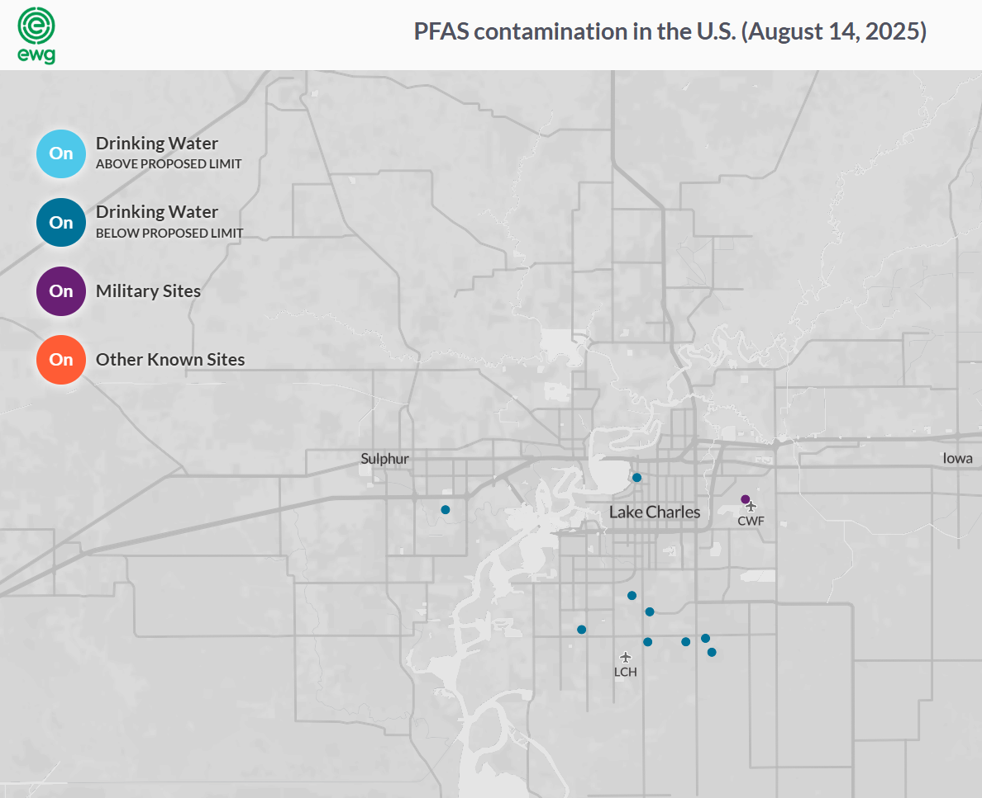

Slide 7
What we know about PFAS in Southwestern Louisiana
The problem in Louisiana is the lack of information regarding PFAS.
State of Louisiana is negligent.
Louisiana, like most states, has found PFAS in the environment where aqueous film forming foams (AFFF) were historically used for putting out fires and training.
Notes:
The problem in Louisiana is the lack of information regarding PFAS. Aside from the former and active military bases listed below, Louisiana is negligent in not considering or testing other known and potential sources of PFAS in the environment and where people are at risk of unknowingly being exposed.
Louisiana is negligent, because there are numerous known municipal and industrial activities that contribute PFAS to the environment and if a state does not proactively test for it, people are likely to be unknowingly exposed.
Louisiana, like most states, has found PFAS in the environment where aqueous film forming foams (AFFF) were historically used for putting out fires and training. Notable sites of PFAS contamination in Louisiana include:
Former England Air Force Base: This site near Alexandria has shown some of the highest PFAS levels recorded in the nation
Barksdale Air Force Base: Groundwater and surface water around the base have been affected by PFAS from AFFF use.
Camp Minden: This site, formerly the Louisiana Army Ammunition Plant (LAAP), has undergone a preliminary assessment for potential PFAS release areas and exposure pathways.
Fort Polk: Listed as a military site with PFAS contamination. As well as industrial sites where fires have been put out.

Slide 8
What we know about PFAS in Southwestern Louisiana
Key to finding potential PFAS sources is for responsible state agencies to sample and assess discharges from known PFAS sources and receiving surface and/or ground water.
Most of the facilities that Micah 6:8 Mission covers use large volumes of flammable/combustible materials and are required by the State Fire Marshal to have appropriate fire-fighting systems in place.
Some facilities may also use PFAS-containing products in their processes or could be using processing aids that contain PFAS. For example, we know that some Chlor-Alkali processes use filters that contain PFAS fibers.
LDEQ must begin assessing PFAS sources in the State that have a potential to impact people or the environment.
Ultimately, LDEQ must begin including requirements to test for and regulate PFAS in municipal and industrial LPDES permits.
Notes:
environment, biosphere and humans. They are difficult to destroy and never go away. That is why they are called “forever chemicals.” If left untested and unchecked, the problem will only get worse

Slide 9
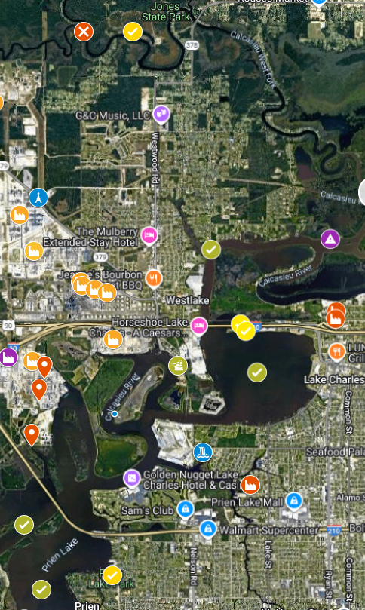
The yellow check marks identify four locations where Cyclopure samples were collected back in March 2025.
All 4 locations are where people would be recreating (boat launch, beach, park, public park and restrooms) and all 4 locations indicated Total PFAS from 2.3 to 4 ppt.
A 5th location, at Bayou D’Inde” indicated Total PFAS at 36.8 ppt.
The importance of this data is that it indicates the presence of PFAS where people can be exposed and, until we tested it, no one knew it was even there.
Notes:
There’s a lot we know about where PFAS is likely present in Southwestern Louisiana, but we had no actual data. So, we did some preliminary sampling.

Slide 10
Testing Results
Sample No. | Oxygination % |  | Total PFAS (ppt)
September | 80-120 optimal, below 54 unhealthy aqautic species life
 |  |  | 4.3
WTK_PFAS_21171 (12) Reynolds (dredging) | 80/61 | 0 detectable VOCs | 4.8
WTK_PFAS_21172 (11) Calcasieu Refining (oil sheen on water) | 74/67 | 0 detectable VOCs | 19.4
WTK_PFAS_21173 (7) Citgo South | 64/64 | 1,2 Dichloroethane .97 (.50) | 4.4
WTK_PFAS_21174 (8) Clifton Ridge (foam on water) | 61/63 | 1,2 Dichloroethane .94 (.50) | 8.6
WTK_PFAS_21175 (6) Citgo North | 68/62 | 1,2 Dichloroethane 1.3 (.50) | 7.1
WTK_PFAS_21176 (2) Williams Point | 32/43 |  | 5.8
WTK_PFAS_21177 (10) Rain Westlake Styene, WR Grace | 91/84 | 1,2 Dichloroethane .94 (.50) | 2.5
WTK_PFAS_21178 (5) Bayou D’Inde/CR | 74/ 49 | 1,2 Dichloroethane .72 (.50) | 6.5
WTK_PFAS_21179 (4) Contraband Bayou/CR | 58/ 50 | 1,2 Dichloroethane 1.9 (.50) | 7.3
WTK_PFAS_21180 (1) Combre Fondel Elementary | 75/ 45 |  | 4.8
 |  | 1,2 Dichloroethane .75 (.50)
WTK_PFAS_21181 (3) Olin/BioLab Outfall | 68/ 51 | 1,2 Dichloroethane 1.2 (.50) | 7.2
March
WTK_PFAS_13329 Choupique Boat Launch |  |  | 4
WTK_PFAS_13388 wastewater, LC |  |  | 2.3
WTK_PFAS_13389 I10 Beach |  |  | 2.6
WTK_PFAS_13390 West Fork (Williams Point) |  |  | 4
WTK_PFAS_13391 Bayou D'Inde |  |  | 36.8
WTK_PFAS_13392 Sulphur Verdine plant drinking water |  |  | 0
Notes:
Affected Organ Systems: Cancer, Developmental (effects while organs are developing), Gastrointestinal (Stomach and Intestines, part of the digestive system), Hepatic (Liver), Immunological (Immune System), Neurological (Nervous System), Ocular (Eyes), Renal (Urinary System or Kidneys), Reproductive (Producing Children)
Summary: 1,2-Dichloroethane, also called ethylene dichloride, is a manufactured chemical that is not found naturally in the environment. It is a clear liquid and has a pleasant smell and sweet taste. The most common use of 1,2-dichloroethane is in the production of vinyl chloride which is used to make a variety of plastic and vinyl products including polyvinyl chloride (PVC) pipes, furniture and automobile upholstery, wall coverings, housewares, and automobile parts. It is also used to as a solvent and is added to leaded gasoline to remove lead.

Slide 11
What do the results mean
The March 2025 data tells us that there is PFAS at the Lake Charles beach and boat launch, Prien Lake Park, Bayou D’Inde, and Calcasieu West Fork. Most states will recommend rinsing off pets and people after even short exposures to surface water contaminated with PFAS.
The September 2025 results tells us that PFAS is present, levels are consistent, and that means we’ve only found the tip of the iceberg.
Every location also included some level of PFOS. PFOS is one of the best known (historic use, adverse health impacts) PFAS compounds. PFOS has a propensity to accumulate in fish and seafood.
An even bigger issue is that we don’t know the levels of PFAS in aquatic life and fish in these water bodies. What we do know is that whatever the ppt level of PFAS in a river or lake is, the levels of PFAS in the fish and seafood will be thousands of time higher (generally > 4,000 times) in parts per billion levels instead of ppt.
Notes:
The March 2025 data tells us that there is PFAS at the Lake Charles beach and boat launch, Prien Lake Park, Bayou D’Inde, and Calcasieu West Fork. These are all areas where there is a potential for people and pets to be exposed to PFAS. There is no warning that it is present or guidance on what to do after swimming or recreating in the area. Most states will recommend rinsing off pets and people after even short exposures to surface water contaminated with PFAS.
The September 2025 results tells us that PFAS is present, levels are consistent, and that means we’ve only found the tip of the iceberg. PFAS was found at every location tested with Location 11 being the highest at 19.4 ppt. Cynthia makes note that #11 is Calcasieu Refining, where a Naptha tank caught fire and AFFF was likely used to put it out. #11 is also the only result that includes a PFAS “precursor” 6:2 FTS (a fluorotelomer) found in AFFF used from 1970s until 2016 that degrades in the environment to PFHxA or PFPeA.
Every location also included some level of PFOS. PFOS is one of the best known (historic use, adverse health impacts) PFAS compounds. PFOS has a propensity to accumulate in fish and seafood.
An even bigger issue is that we don’t know the levels of PFAS in aquatic life and fish in these water bodies. What we do know is that whatever the ppt level of PFAS in a river or lake is, the levels of PFAS in the fish and seafood will be thousands of time higher (generally > 4,000 times) in parts per billion levels instead of ppt.

Slide 12
Comparison between PFAS in surface water and pfas in fish
Water Body | PFOS in Surface Water (ppt) | PFOS in Fish (ppt) | Fish how many times higher than SW
Squaw Lake near Sparta | Not detected | 17,200.0 | 17,200
Rood Lake near Lapeer | 1.2 | 28,600.0 | 23,833
Lake Doster near Plainwell | 1 | 11,800.0 | 11,800
Loon Lake near Wixom | 14.6 | 188,000.0 | 12,877
Thornapple River | 8 | 20,000.0 | 2,500
Rogue River | 8.1 - 30 | 117,000.0 | 5,850
Pere Marquette River and Lake | Maximum of 100 | 294,000.0 | 2,940
Black River Watershed | 72.2 | 198,000.0 | 2,742
Clark’s Marsh | 9 to 150 | 2,870,000.0 | 19,133

Slide 13
Use stainless steel or cast-iron cookware rather than “nonstick” pots and pans.
Don’t treat carpeting or furniture with stain-resistant sprays. Instead, leave shoes at the door to minimize dirt and spot clean spills as they happen. If you have furniture and carpet professionally cleaned, opt for steam cleaning with fragrance-free, water-based cleansers and forgo stain treatment afterward.
Make your own popcorn rather than use microwave bags that often are lined with PFA-based non-stick coatings.
Buy safer cosmetics. A study by the Environmental Working Group (EWG) found Teflon in foundation, sunscreen/moisturizer, eye shadow, bronzer/highlighter, facial powder, sunscreen/makeup, mascara and other eye makeup, and various moisturizers. Search “Teflon-free” or “PFAS-free” cosmetics to find safer alternatives.
Consider installing in-home water treatment filters that are certified to lower the levels of PFAS in your water. EPA recommends these systems for in-home water treatment filters.
Avoid eating fish from waterways impacted by PFAS. You can determine which waterways are of concern by contacting your state or tribal fish advisory programs using EPA’s list of state, territory, and tribal fish advisory contacts.
Notes:
But the EWG researchers found that one serving of fish can be equivalent to a month's worth of drinking water contaminated with 48 parts per trillion of PFOS. Store-bought fish caught in the ocean, like imported Atlantic salmon and canned chunk tuna, appear to have lower PFAS levels, according to FDA research.

Slide 14


