Slide 1
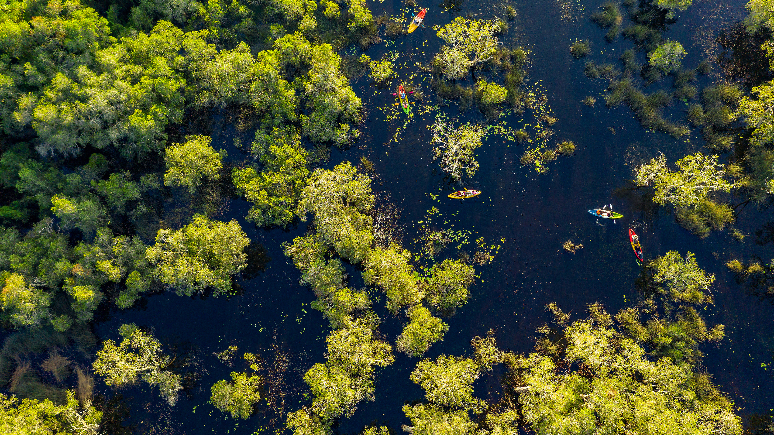

Overview of the proposed facility and CO2 pipeline:
Lake Charles Methanol II, LLC
ZORA DJENOHAN
Senior Associate Attorney

Slide 2

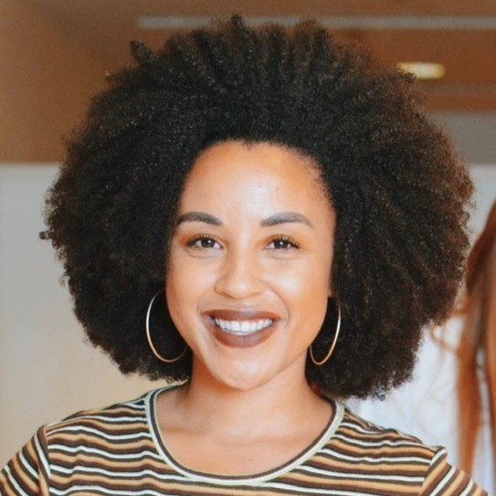
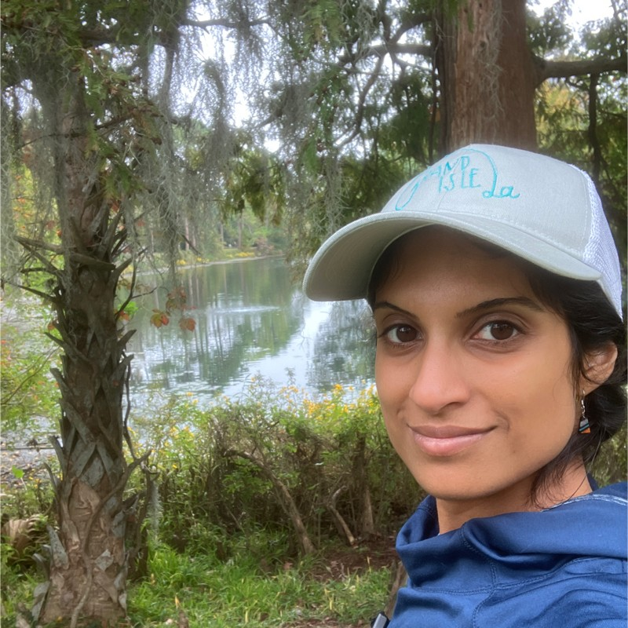
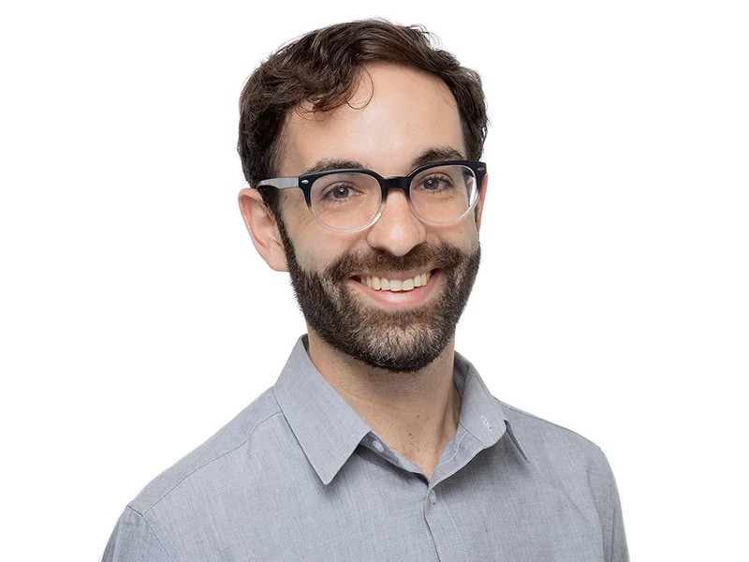
Who we are
Earthjustice’s Fossil Fuels Program is taking on the fossil fuel industry’s efforts to pursue new paths to profit that not only accelerate the climate crisis, but also continue to cause harm to marginalized communities.
ZORA DJENOHAN
MICHAEL BROWN
CYNDHIA RAMATCHANDIRANE
Senior Associate Attorney
Senior Attorney
Staff Scientist

Slide 3
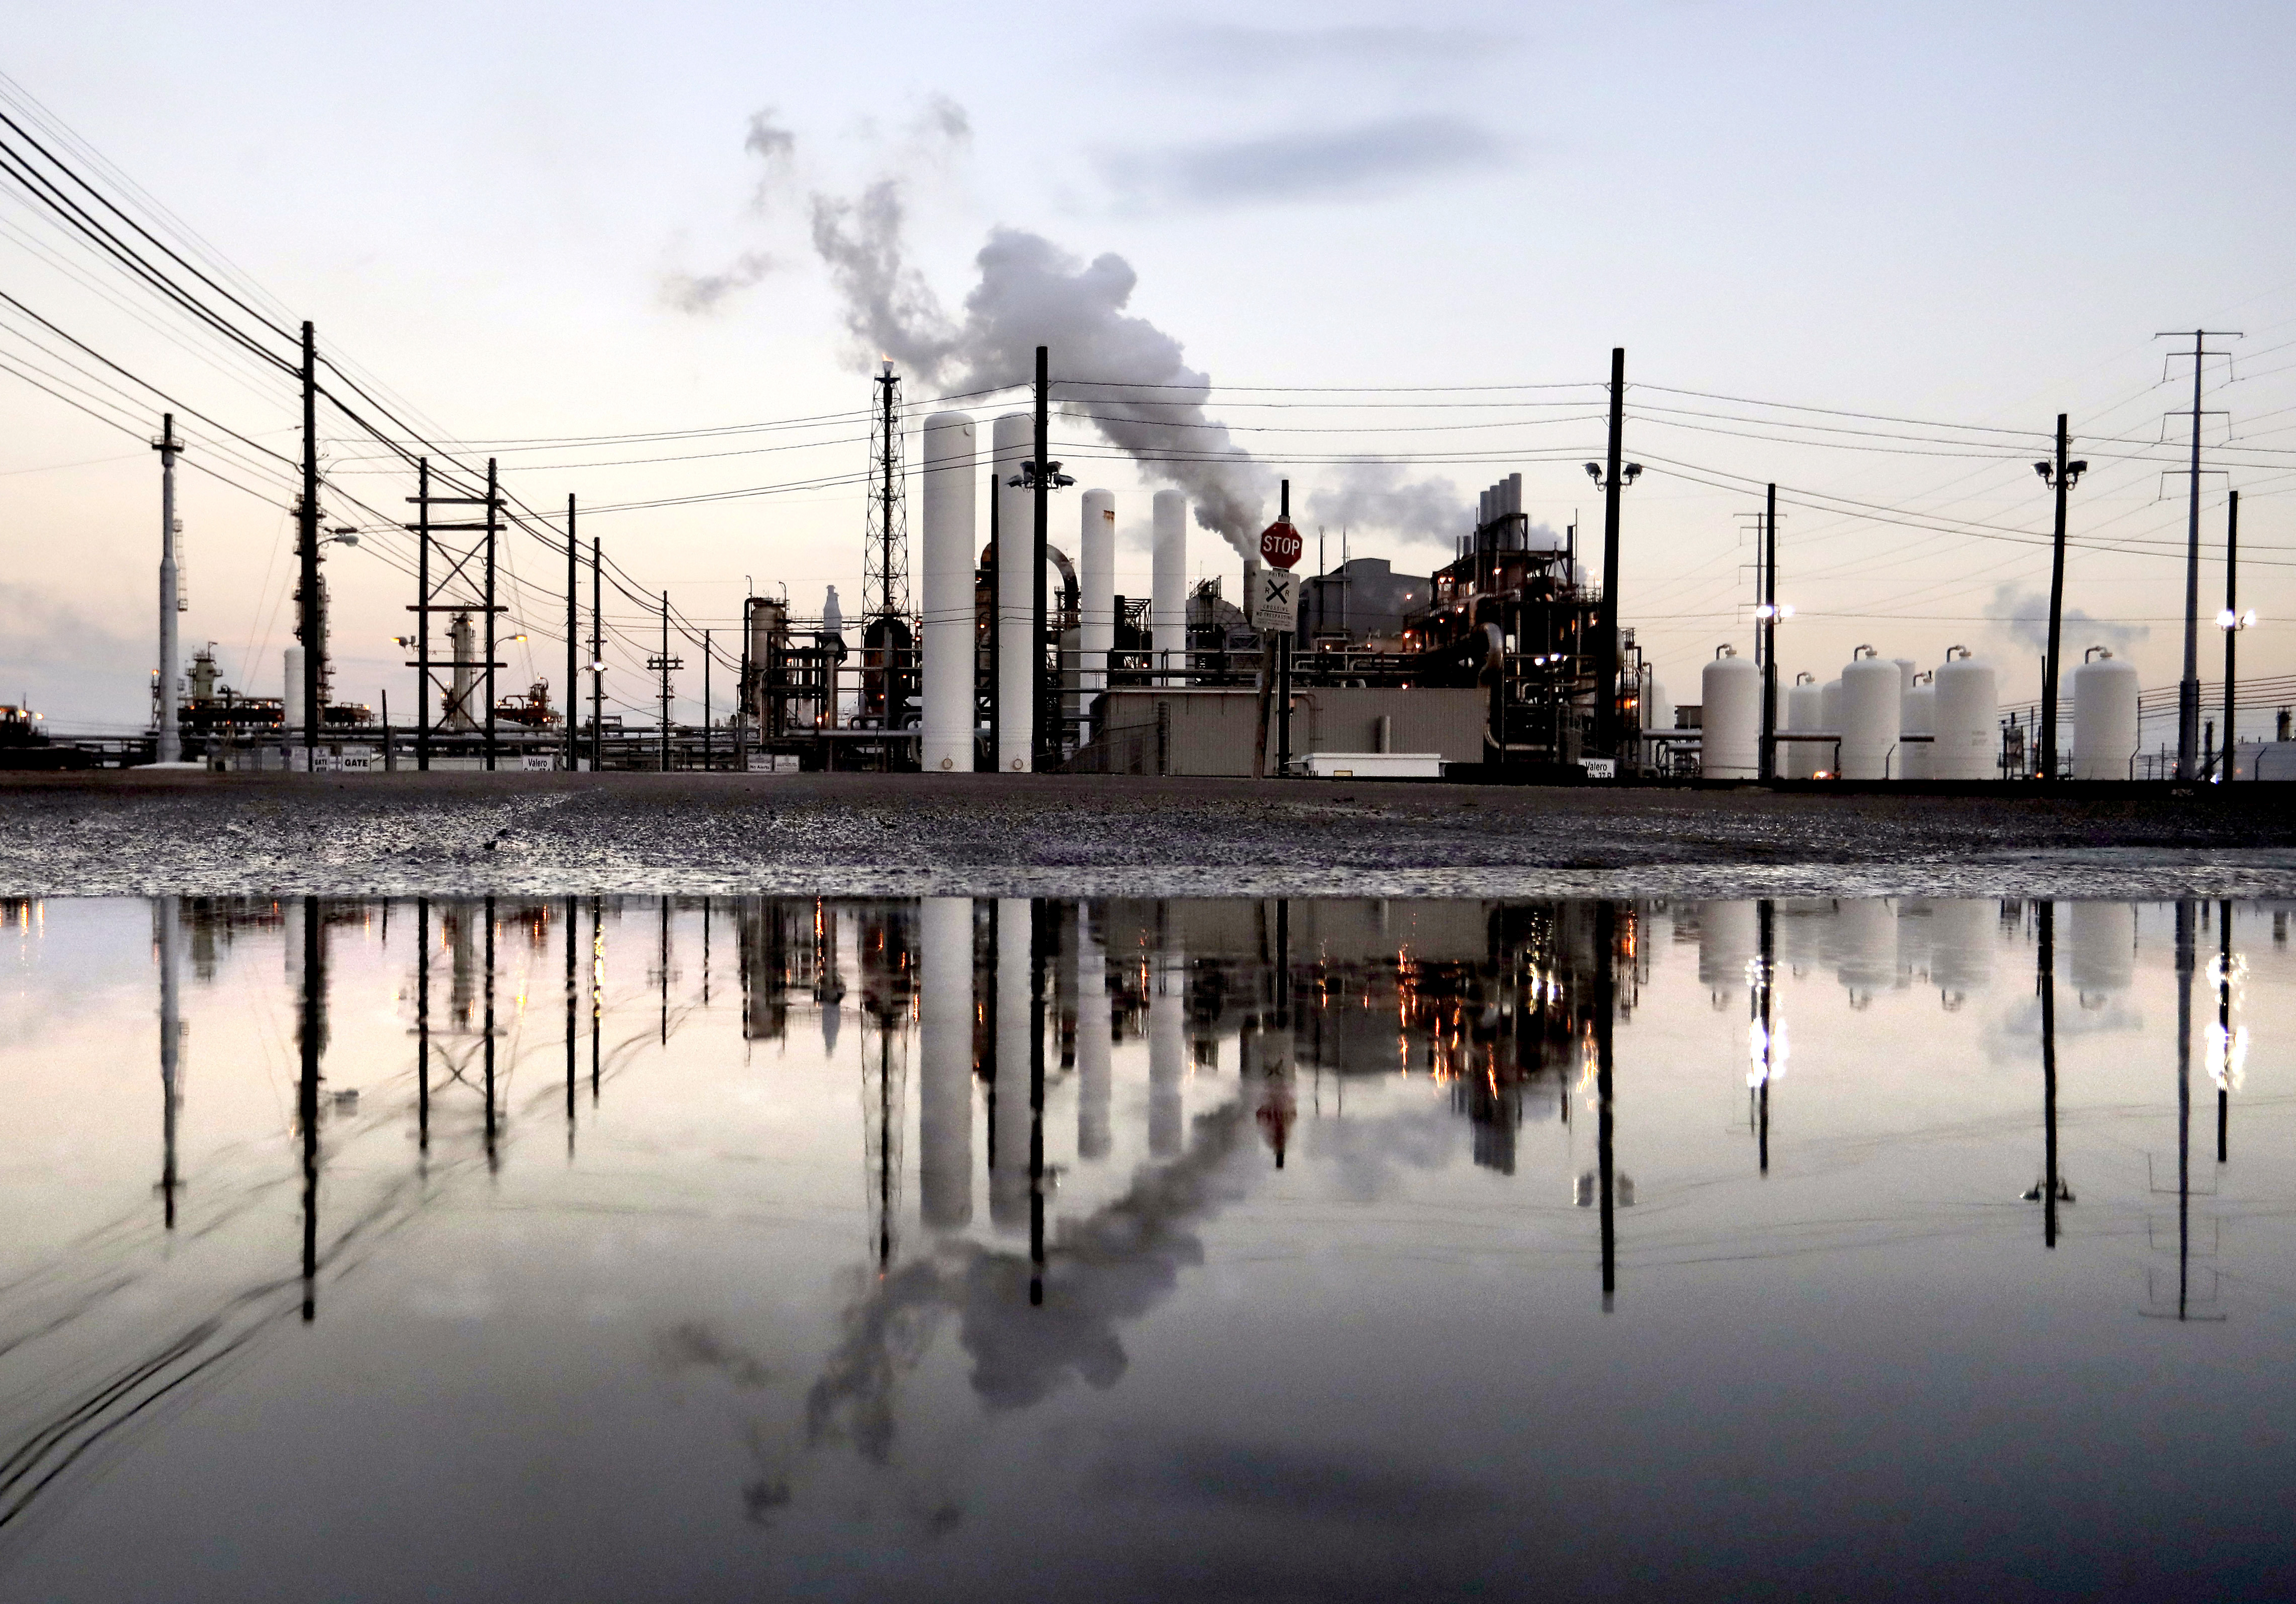
OUTLINE
Project overview
CO2 Pipeline risks
Advocacy opportunities

Slide 4
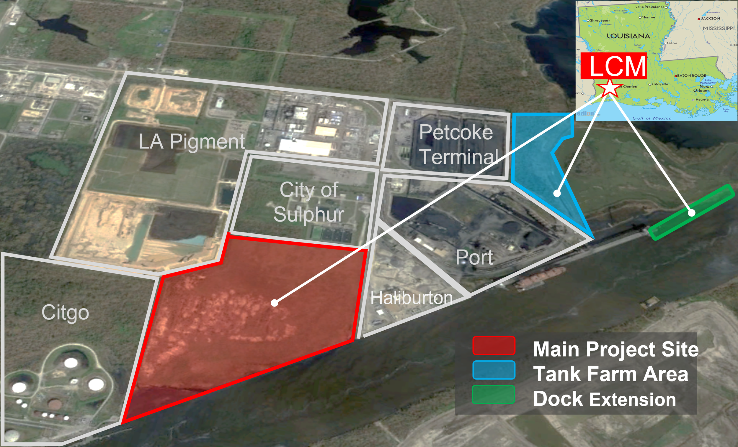
Project Overview: Lake Charles Methanol II, LLC
Animal shelter
LCM II would be “blue” methanol production facility with carbon capture and sequestration
Project also includes tank farm, shipping terminal, and the proposed Lake Charles Lateral CO₂ pipeline
Over a decade of various proposed projects at this site
Image from: https://www.lakecharlesmethanol.com/lake-charles

Slide 5
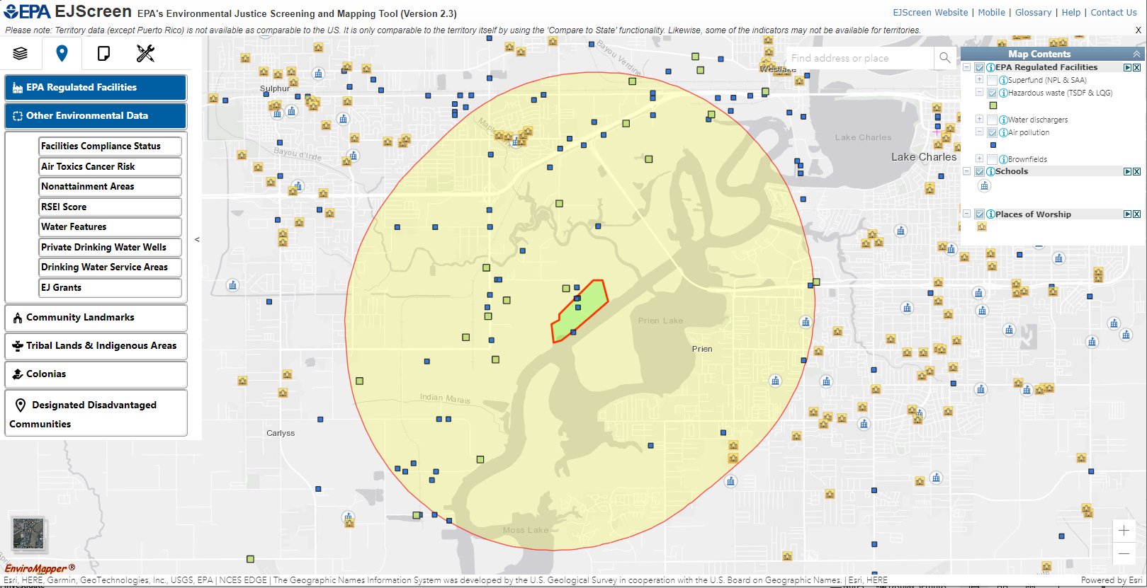
Project Area

Slide 6
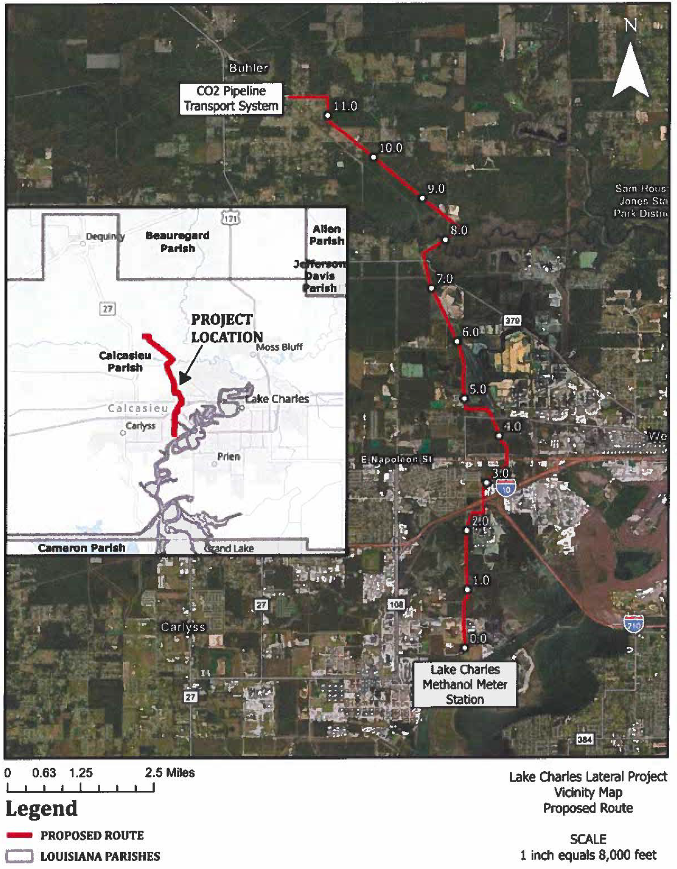
Lake Charles Lateral CO₂ pipeline
11.8 miles long and up to 12-inch pipeline diameter with associated valves and meter stations
Connect the proposed Lake Charles Methanol II facility to the existing Denbury/Exxon CO2 pipeline
CO2 transported via pipeline for EOR and/or geologic sequestration in Texas
LCM claims 99% carbon reduction in carbon emissions using CCS
Map from Certificate of Public Necessity PL 25-016.

Slide 7
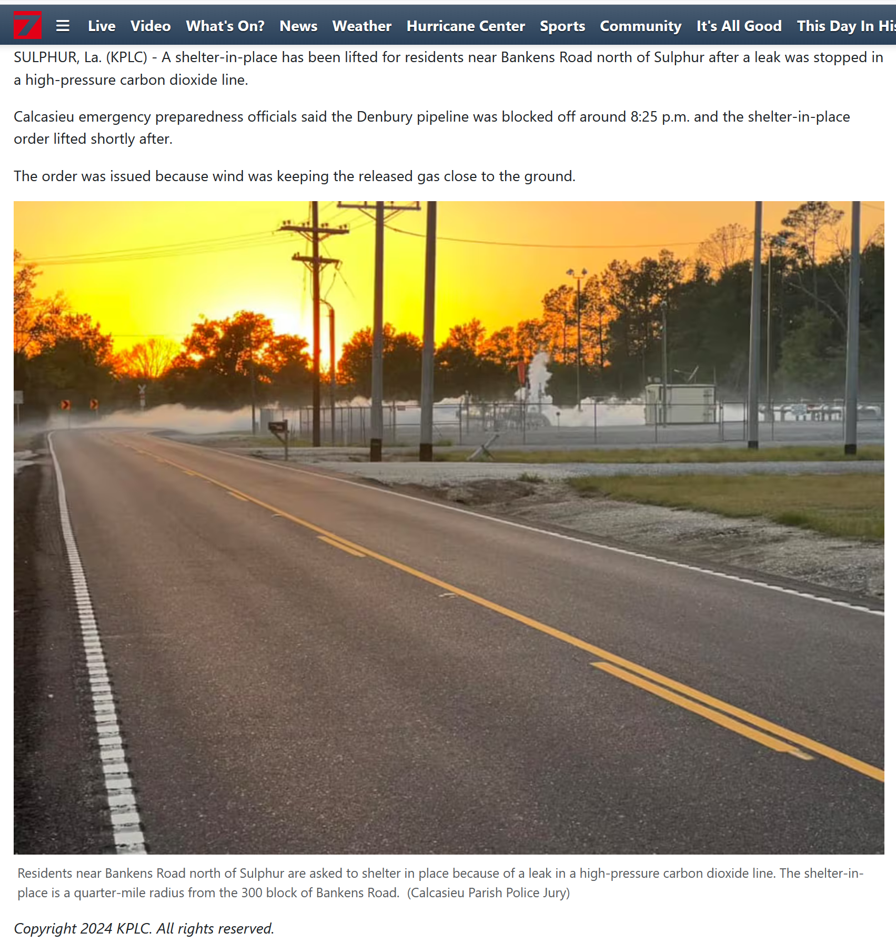
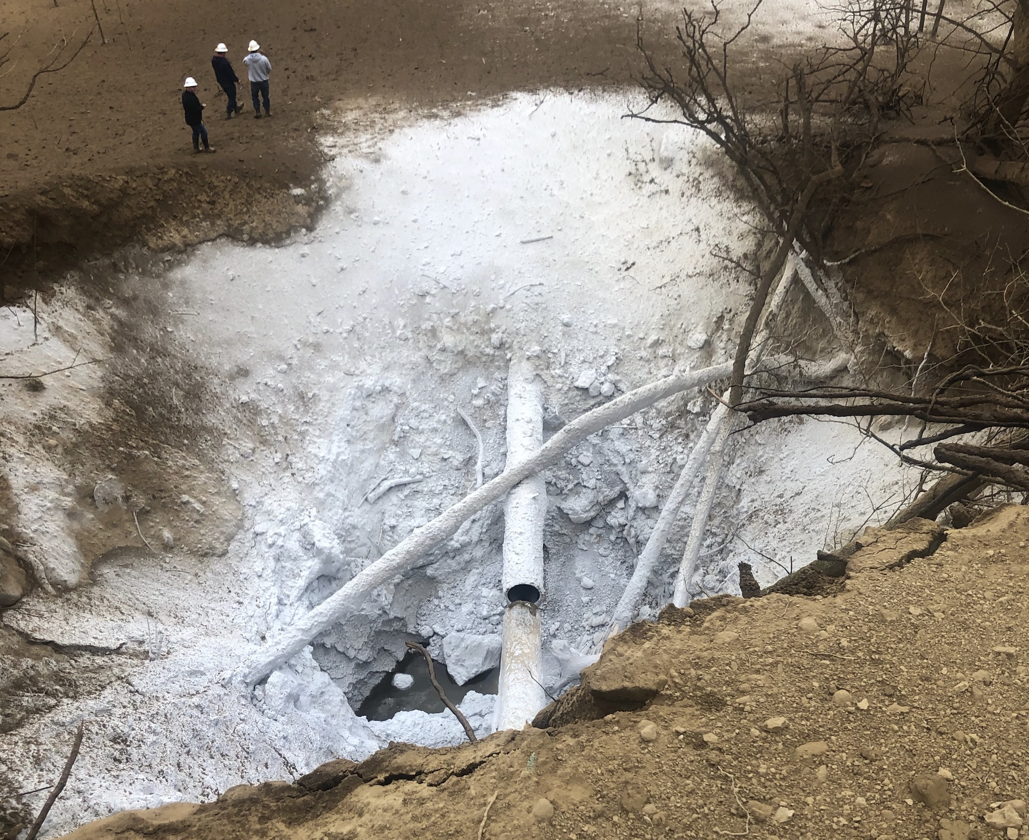
CO₂ Pipeline Risks
This project is part of a much larger build out of new CO₂ pipeline infrastructure across the state
CO₂ pipelines pose a number of risks to communities
Corrosion
Public health and safety
Examples: Satartia, MS in 2020, and Sulphur, LA in 2024
CO₂ pipeline rupture near Satartia, MS, Feb 2020

Slide 8
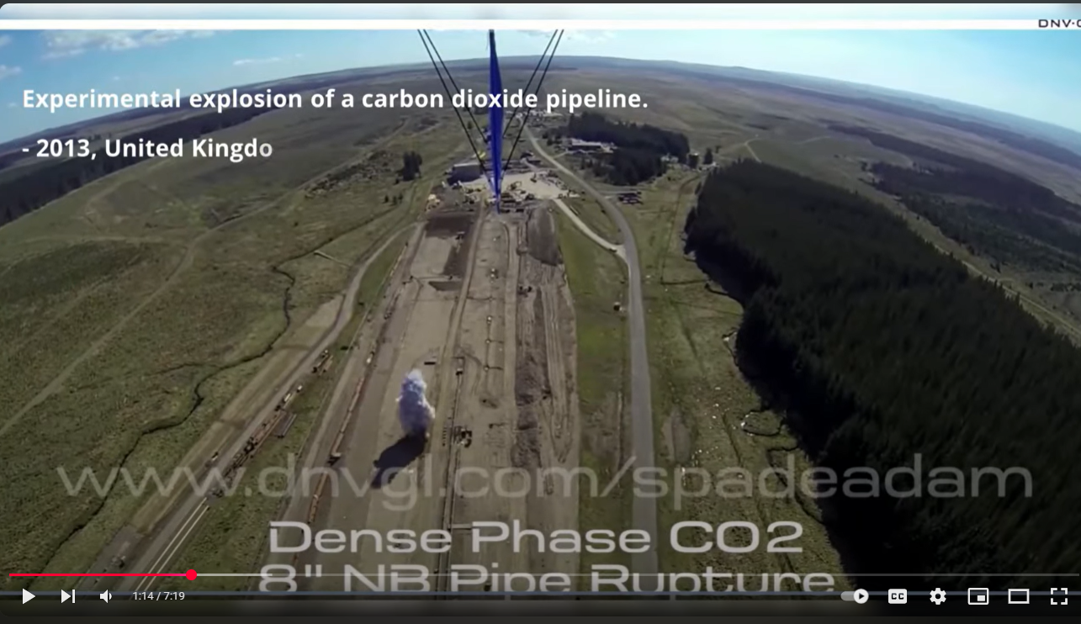
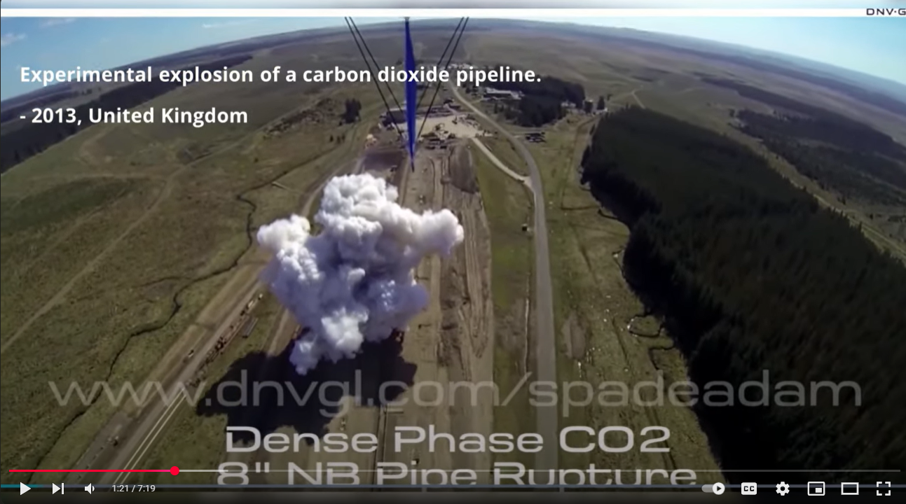
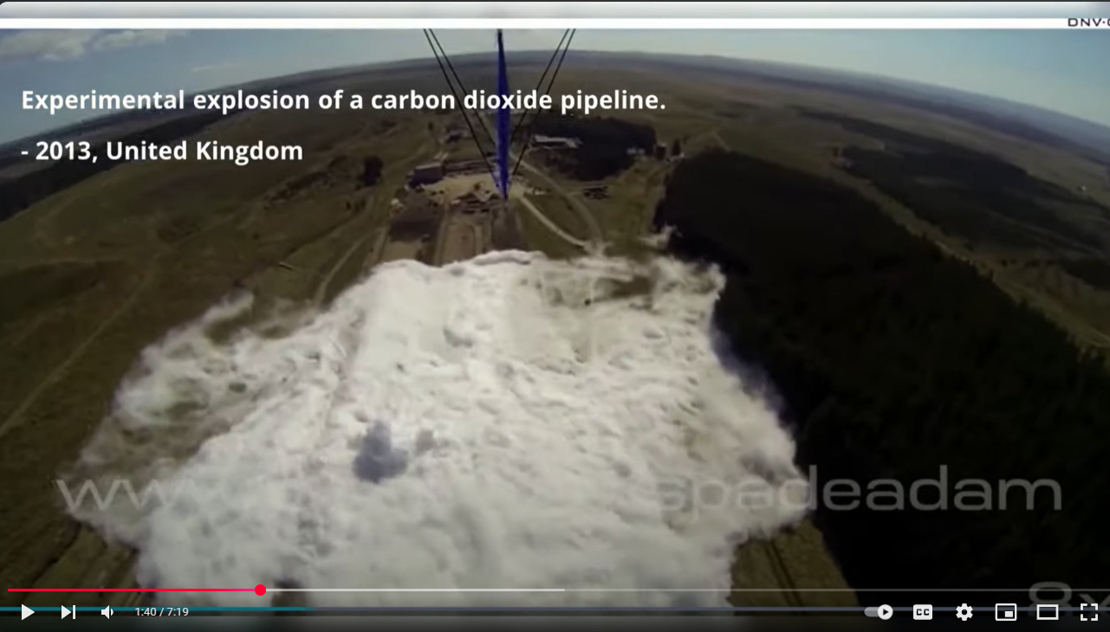
CO₂ Pipeline Risks
The reality of carbon capture: Mississippi CO2 Pipeline Explosion. Victims and Rescuers tell story.
https://www.youtube.com/watch?v=yGIXeWktiWU
Experimental explosion shows movement over flat terrain, first upward, then dense overland spread, up to 2 miles

Slide 9
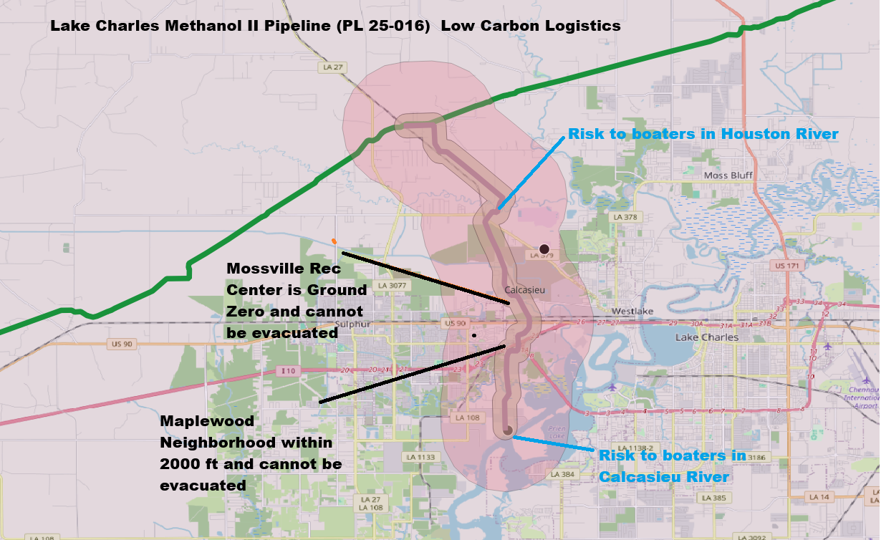
CO₂ Pipeline proposed route
Map from Scott Eustis, Healthy Gulf. Additional link to explore: https://www.google.com/maps/d/viewer?mid=18vKag-dTa11TYLNE6DC85CEn-XLj6P8&ll=30.245968049945024%2C-93.27751177268291&z=12

Slide 10
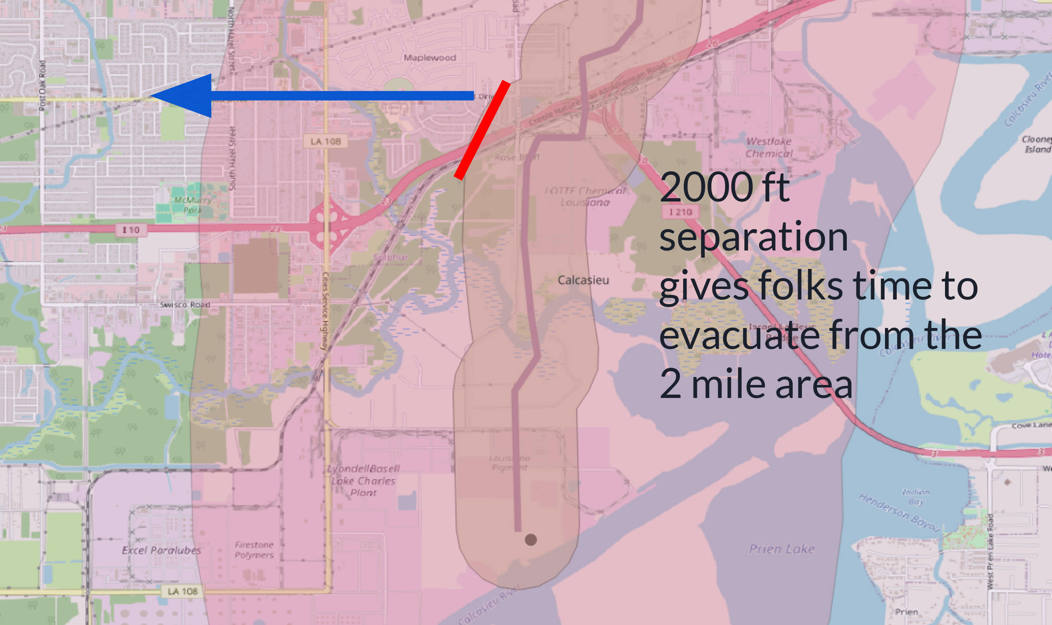
CO₂ Pipeline proposed route
Map from Scott Eustis, Healthy Gulf. Additional link to explore: https://www.google.com/maps/d/viewer?mid=18vKag-dTa11TYLNE6DC85CEn-XLj6P8&ll=30.245968049945024%2C-93.27751177268291&z=12

Slide 11
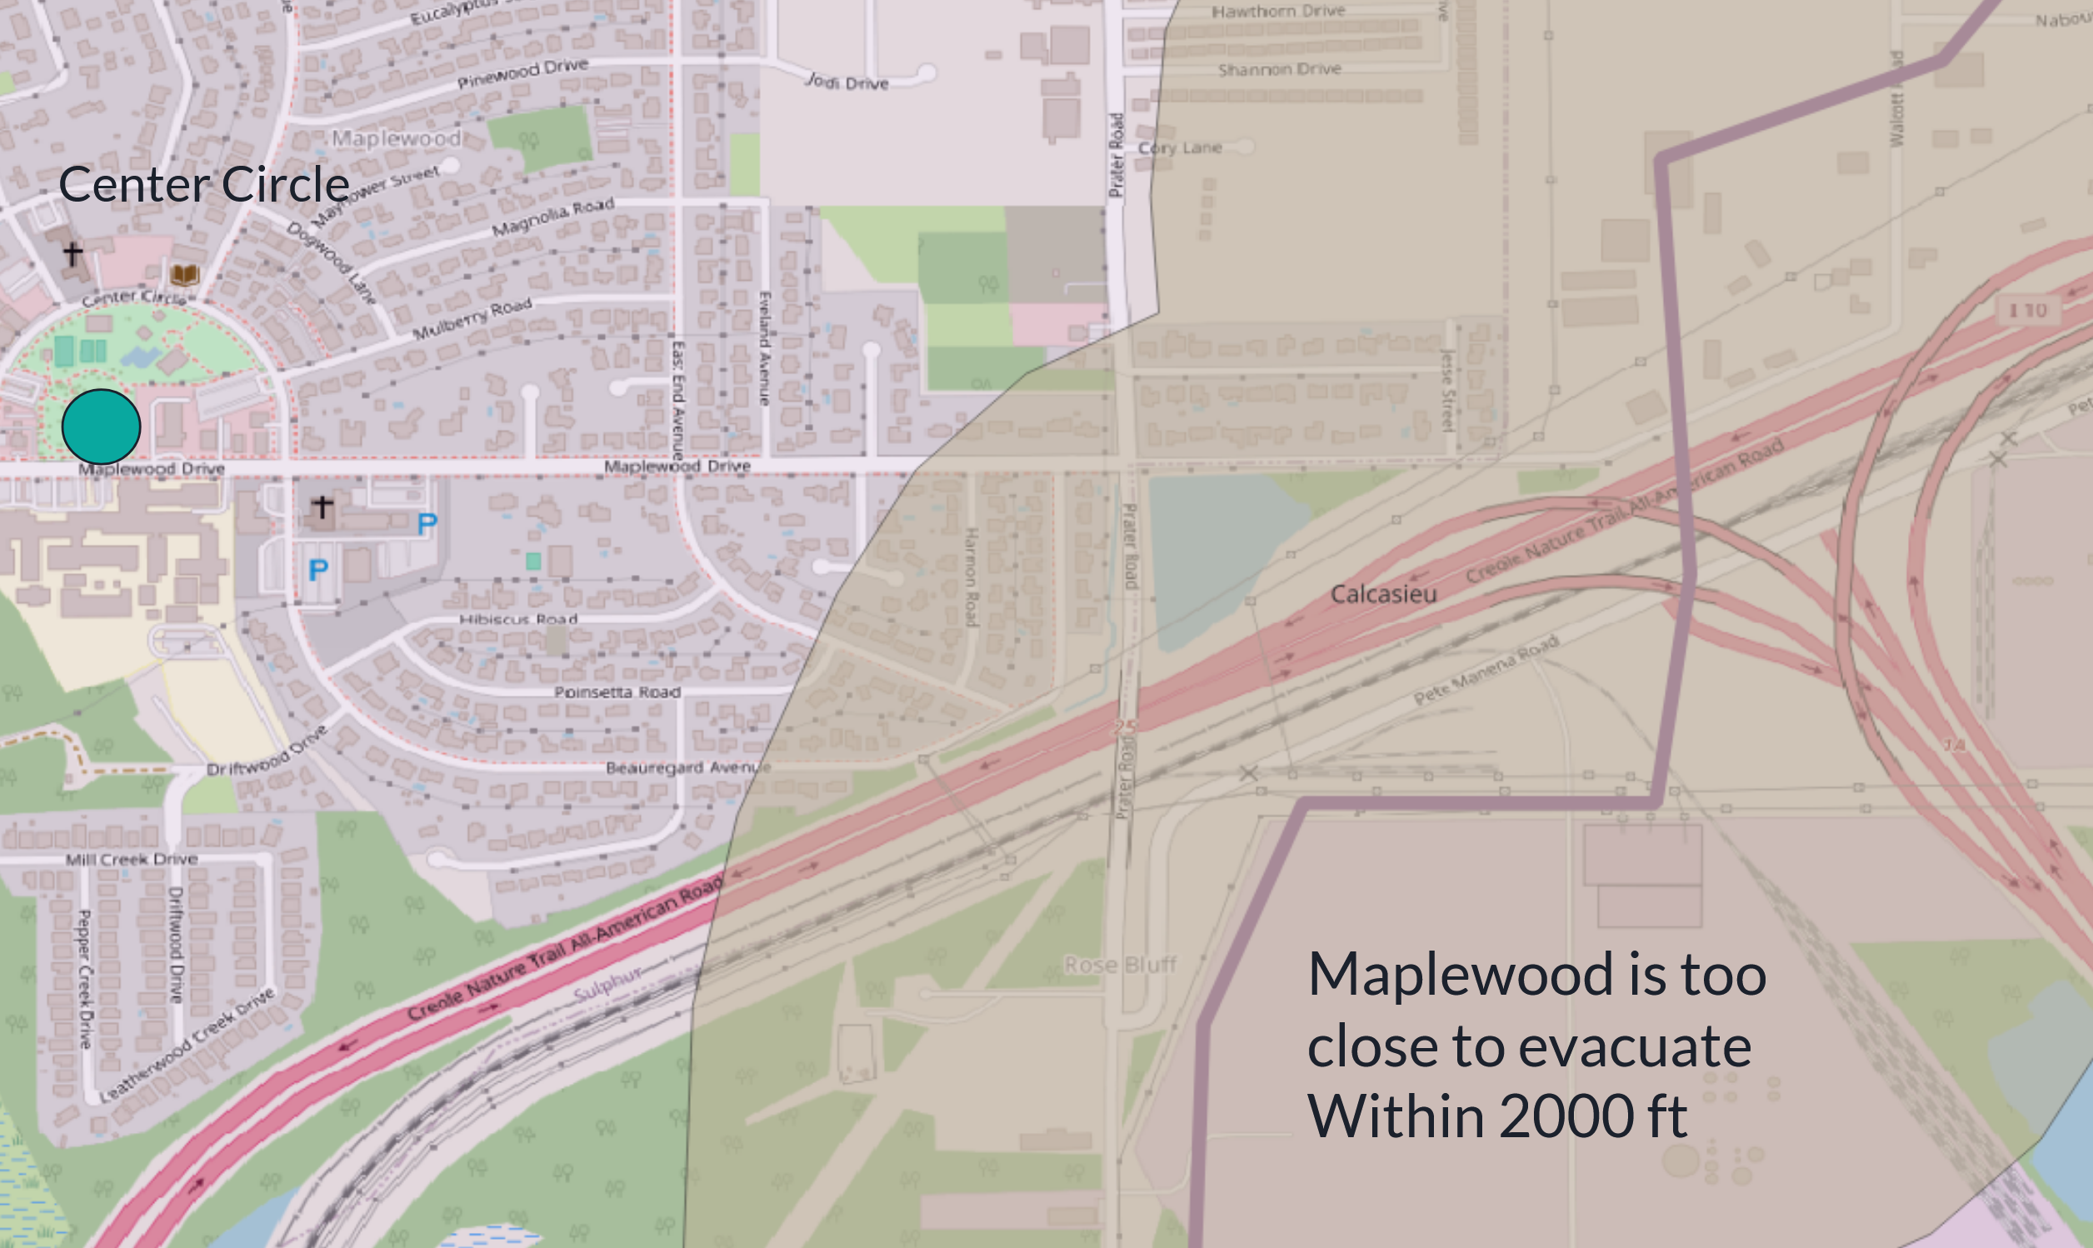
CO₂ Pipeline proposed route
Map from Scott Eustis, Healthy Gulf. Additional link to explore: https://www.google.com/maps/d/viewer?mid=18vKag-dTa11TYLNE6DC85CEn-XLj6P8&ll=30.245968049945024%2C-93.27751177268291&z=12

Slide 12
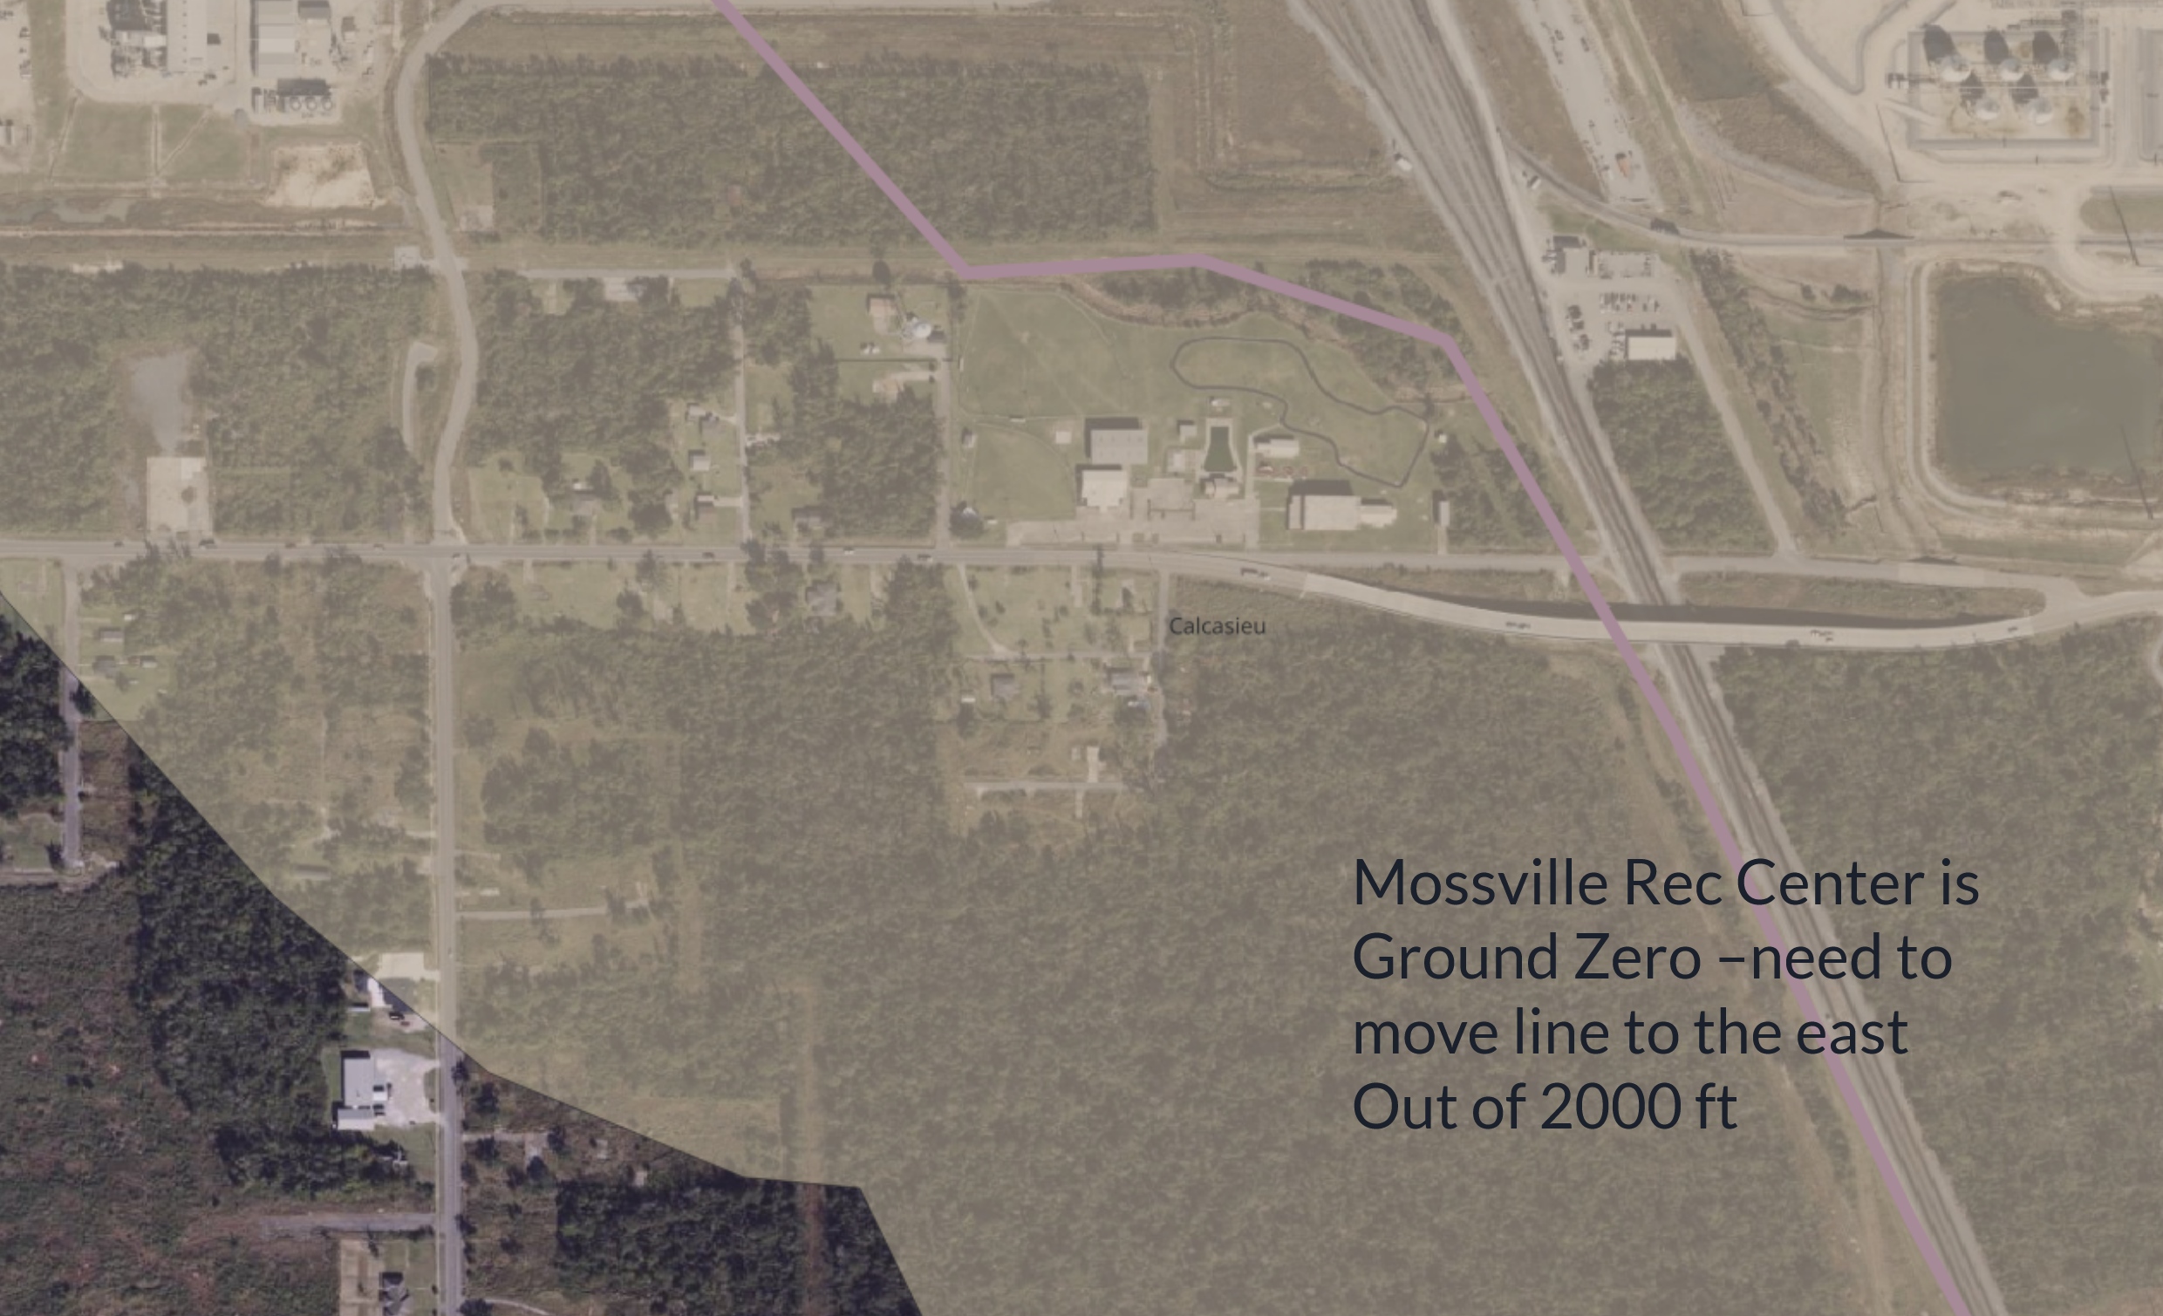
CO₂ Pipeline proposed route
Map from Scott Eustis, Healthy Gulf. Additional link to explore: https://www.google.com/maps/d/viewer?mid=18vKag-dTa11TYLNE6DC85CEn-XLj6P8&ll=30.245968049945024%2C-93.27751177268291&z=12

Slide 13
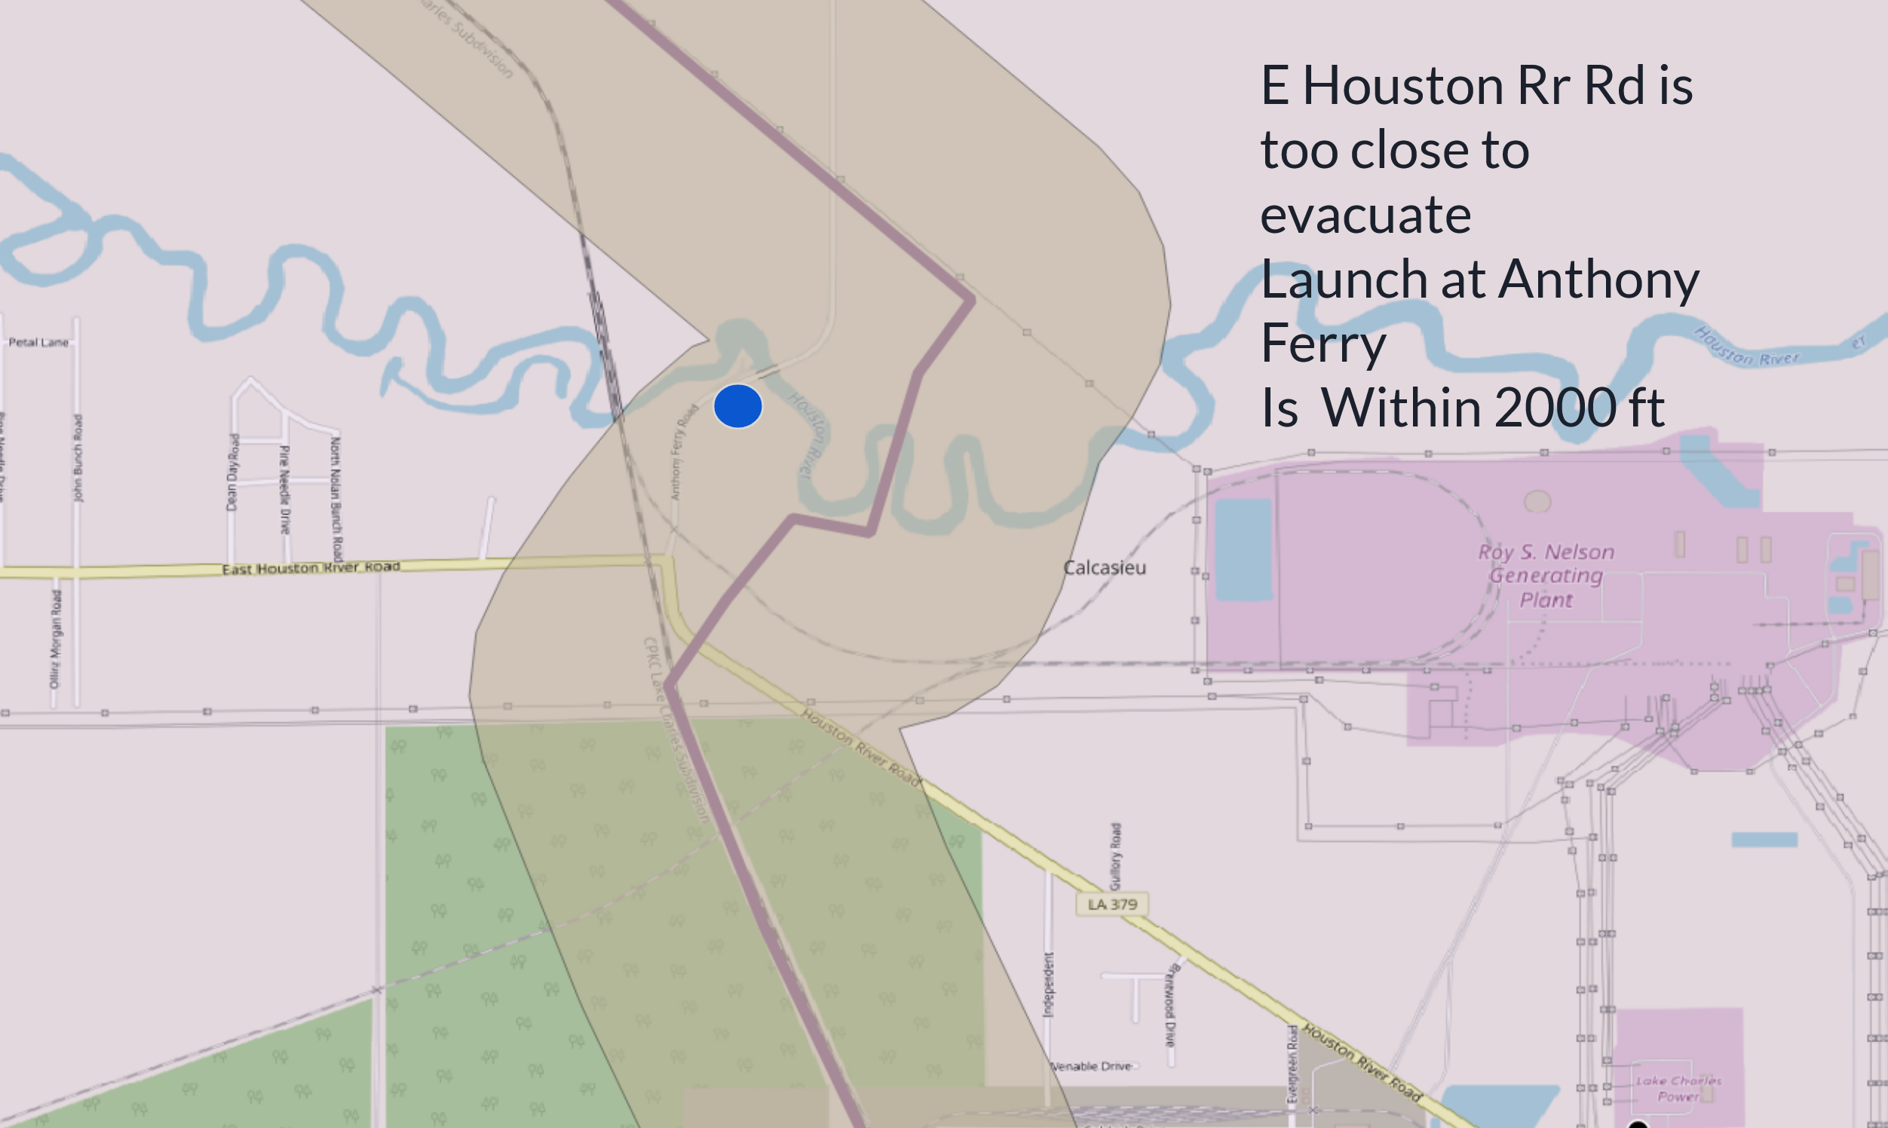
CO₂ Pipeline proposed route
Map from Scott Eustis, Healthy Gulf. Additional link to explore: https://www.google.com/maps/d/viewer?mid=18vKag-dTa11TYLNE6DC85CEn-XLj6P8&ll=30.245968049945024%2C-93.27751177268291&z=12

Slide 14
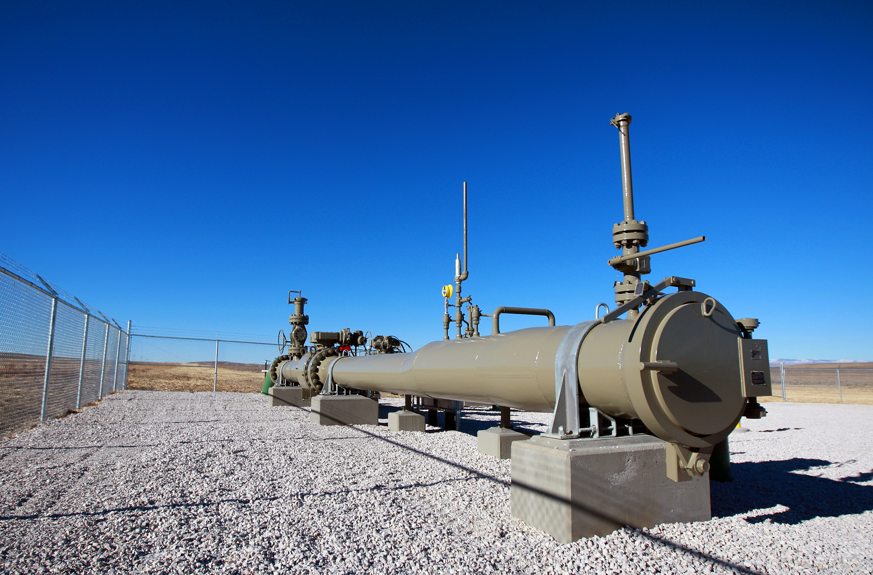
Summary of CO₂ Pipeline Concerns
Lack of plume modeling
Lack of adequate buffer zone
2,000 ft - 2 miles
Emergency planning and response

Slide 15
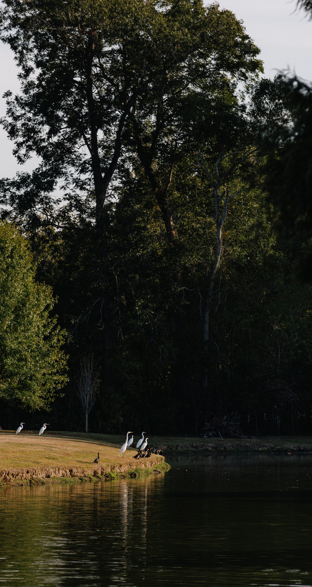
What’s on the Horizon:
Community education and advocacy
Parish level advocacy
Lake Charles Harbor and Terminal District
Certificate of Public Convenience and Necessity
Army Corps approvals
Notes:
No immediate action on LCM, but you can join emails lists and facebook groups that are fighting CCS across the state right at this moment
Conference organizers will prioritize funding travel assistance for people who live near pipelines or are affected by pipeline issues. Contact me or Cindy for more info on this.
What the call to action is going to be is to come to the Community Connections Sunday and we are going to come up with a plan to fight this pipeline, and I am also going to invite folks who are interested to attend the Pipeline Safety Trust Annual meeting.
It would be helpful if you would give me something to help the community plan for upcoming action on both the CO2 pipeline and LCMII. I think if we can hook the two together in people's minds (as they are actually hooked together already) we can start to engage folks on fighting other fronts also.
I am going to do a very short presentation at the Sunday meeting showing people the Oil & Gas Watch website on the 3 permits we are working on this month (Bio-Lab, SASOL and Westlake South) after we talk about what to do about the CO2 pipeline. Hopefully I won't lose the folks who are just interested in the pipeline and start to expand people's minds.
So how can we involve the community in the work we are doing on LCMII? I am going to underscore that I tried to get the City of Sulphur to deny the Entergy right of way, so I can let them know there may be other opportunities to go to public meetings and make our concerns known. Would that make any difference with the Port?

Slide 16
Community education and advocacy:
Attend Community Connections Sunday with Micah 6:8 Mission to learn about future opportunities to comment.
Attend Pipeline Safety Trust Conference in New Orleans, November 13 & 14.

Slide 17
Parish Level Advocacy:
Demand parish ordinance to provide for:
Plume modeling
Buffer zones & set back requirements
Companies fund emergency planning and response

Slide 18
Lake Charles Harbor and Terminal District:
End lease option for LCM II
Increase public transparency and engagement

Slide 19
Certificate(s) of Public Convenience and Necessity
What is a CPCN?
Eminent domain
Who can access the public hearing process
General public
“Interested Parties”

Slide 20
Army Corps approvals:
Previous public comments
Upcoming CWA 404 approvals

Slide 21



Slide 22
Additional resources:
Louisiana Certificate of Convenience and Public Necessity
Louisiana CCS factsheet
Iowa Easement Team website
Texas Easement Action Alliance website
Indiana Action Team website
Webinar for South Dakota Easement Team
Hoosiers' Guide to CCS

